Slide 1
Validation Data Creation

Slide 3
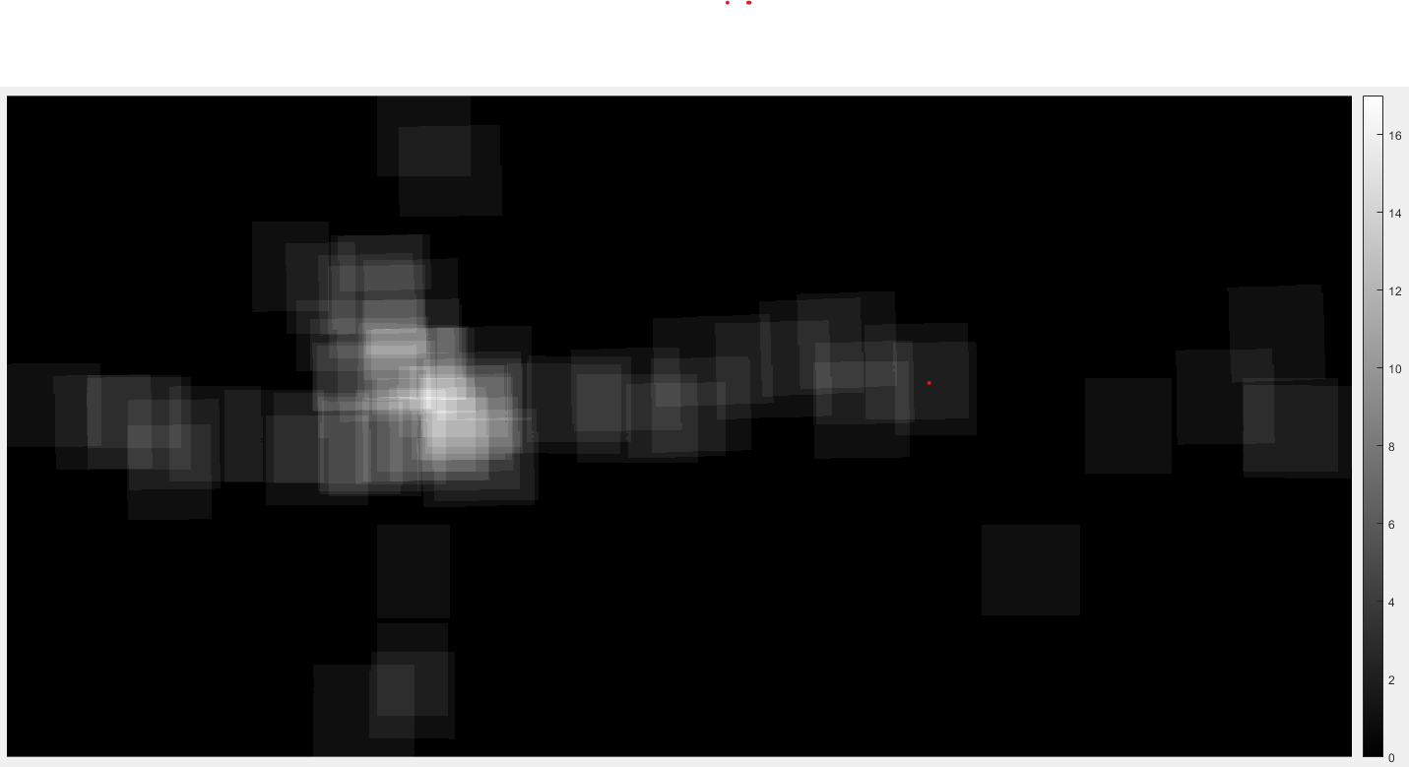
Overlap Count

Slide 4
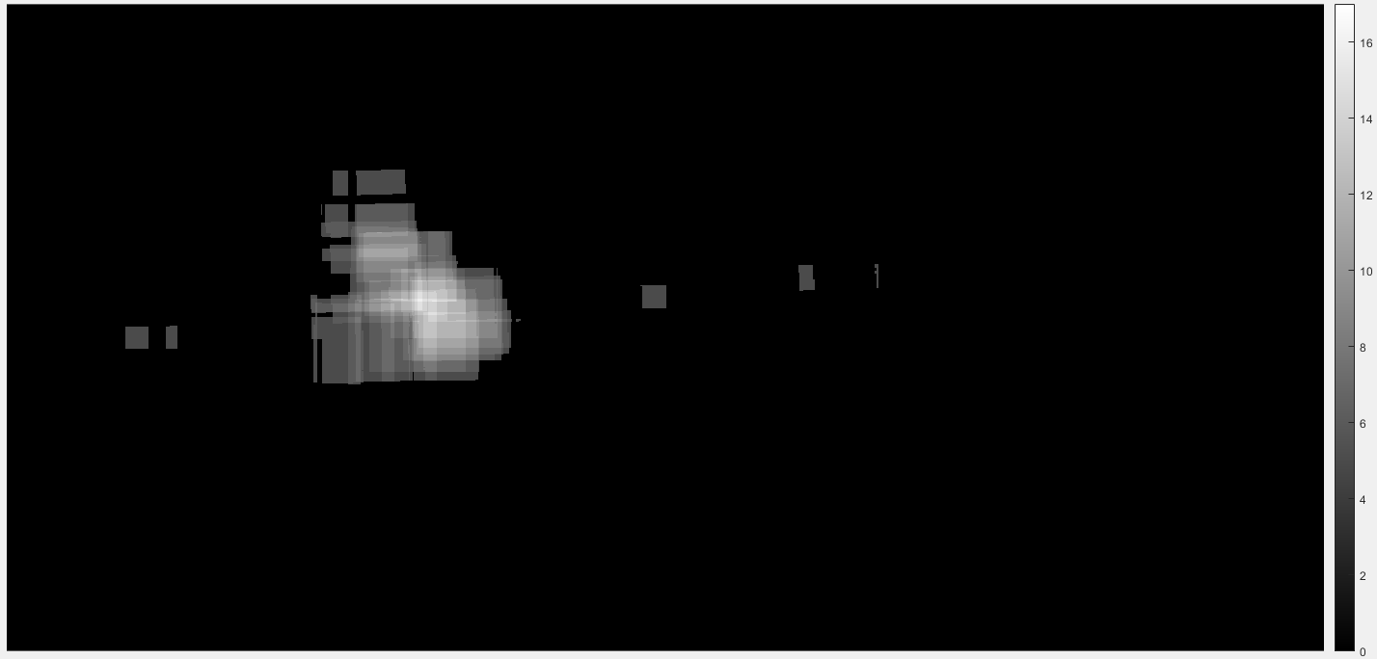
Overlap Count >= 5

Slide 5
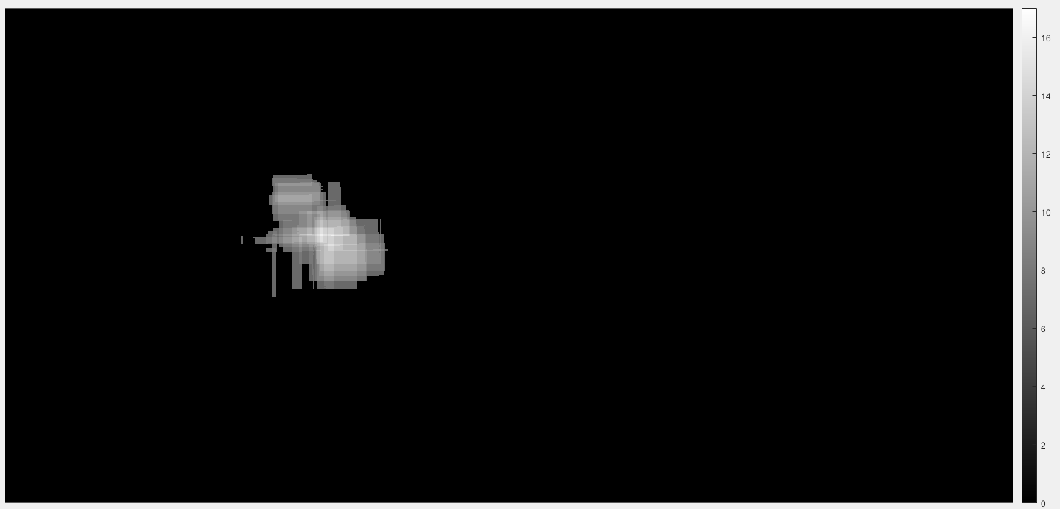
Overlap Count >= 7

Slide 6
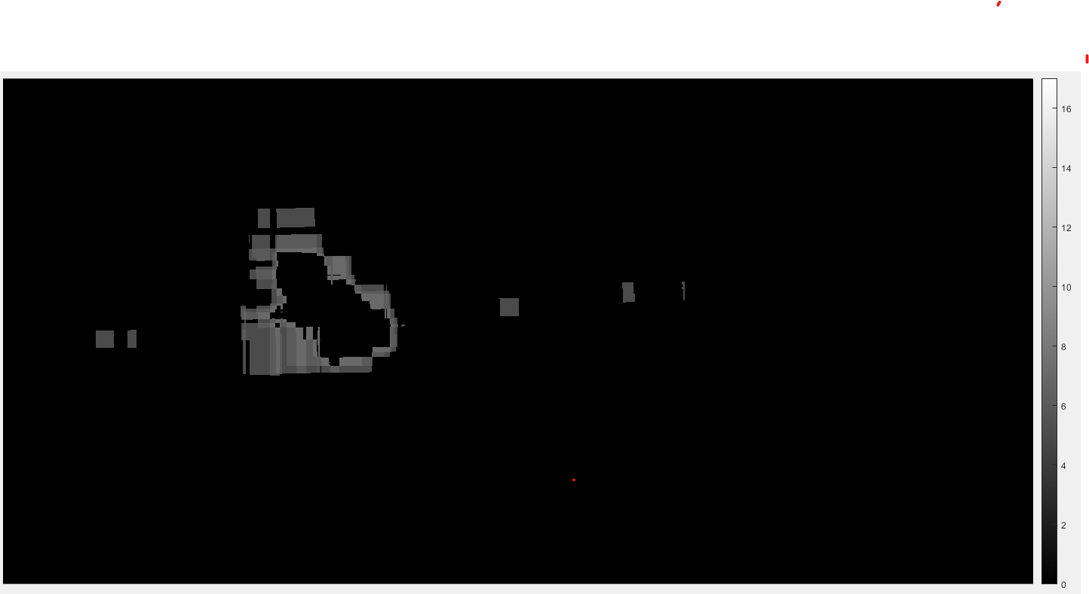
Overlap Count >= 5 & <=7

Slide 7
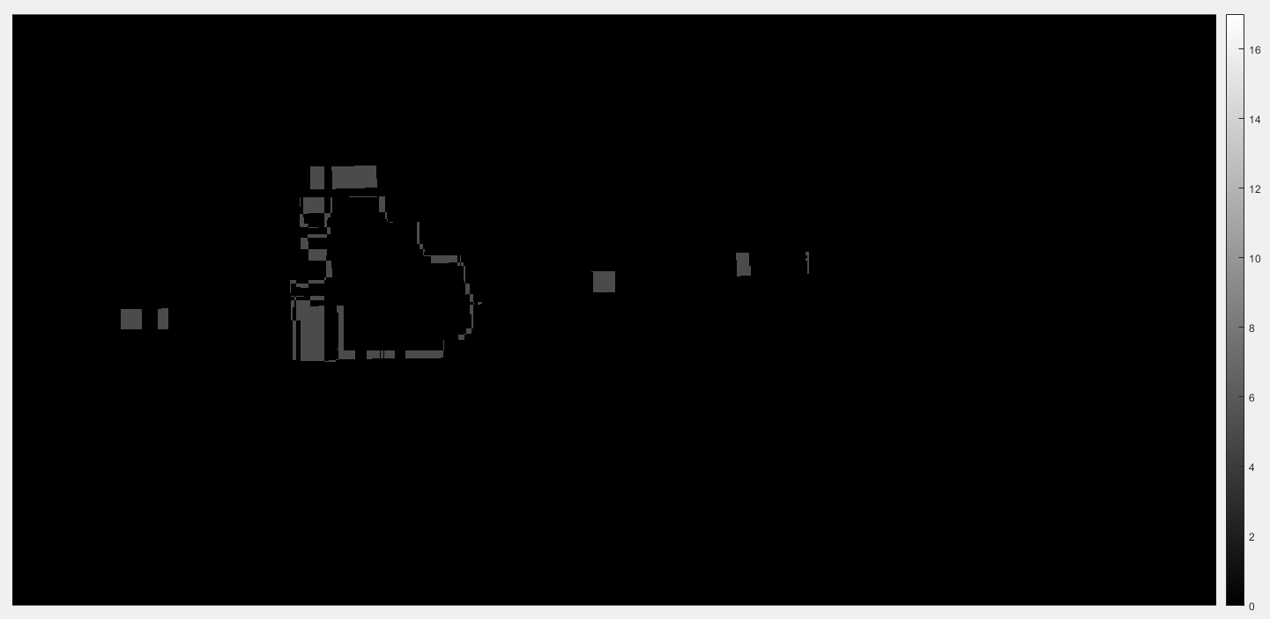
Overlap Count == 5

Slide 8
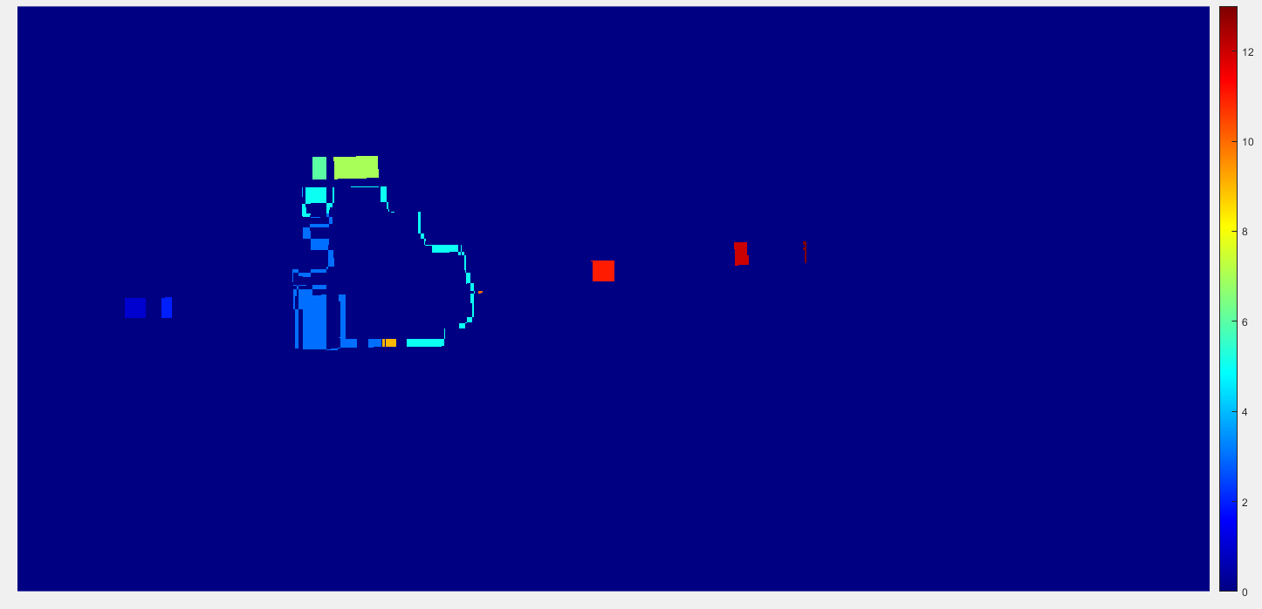
Seed Creation (Using connected components)

Slide 9
Seed Creation (Using connected components)

Slide 10
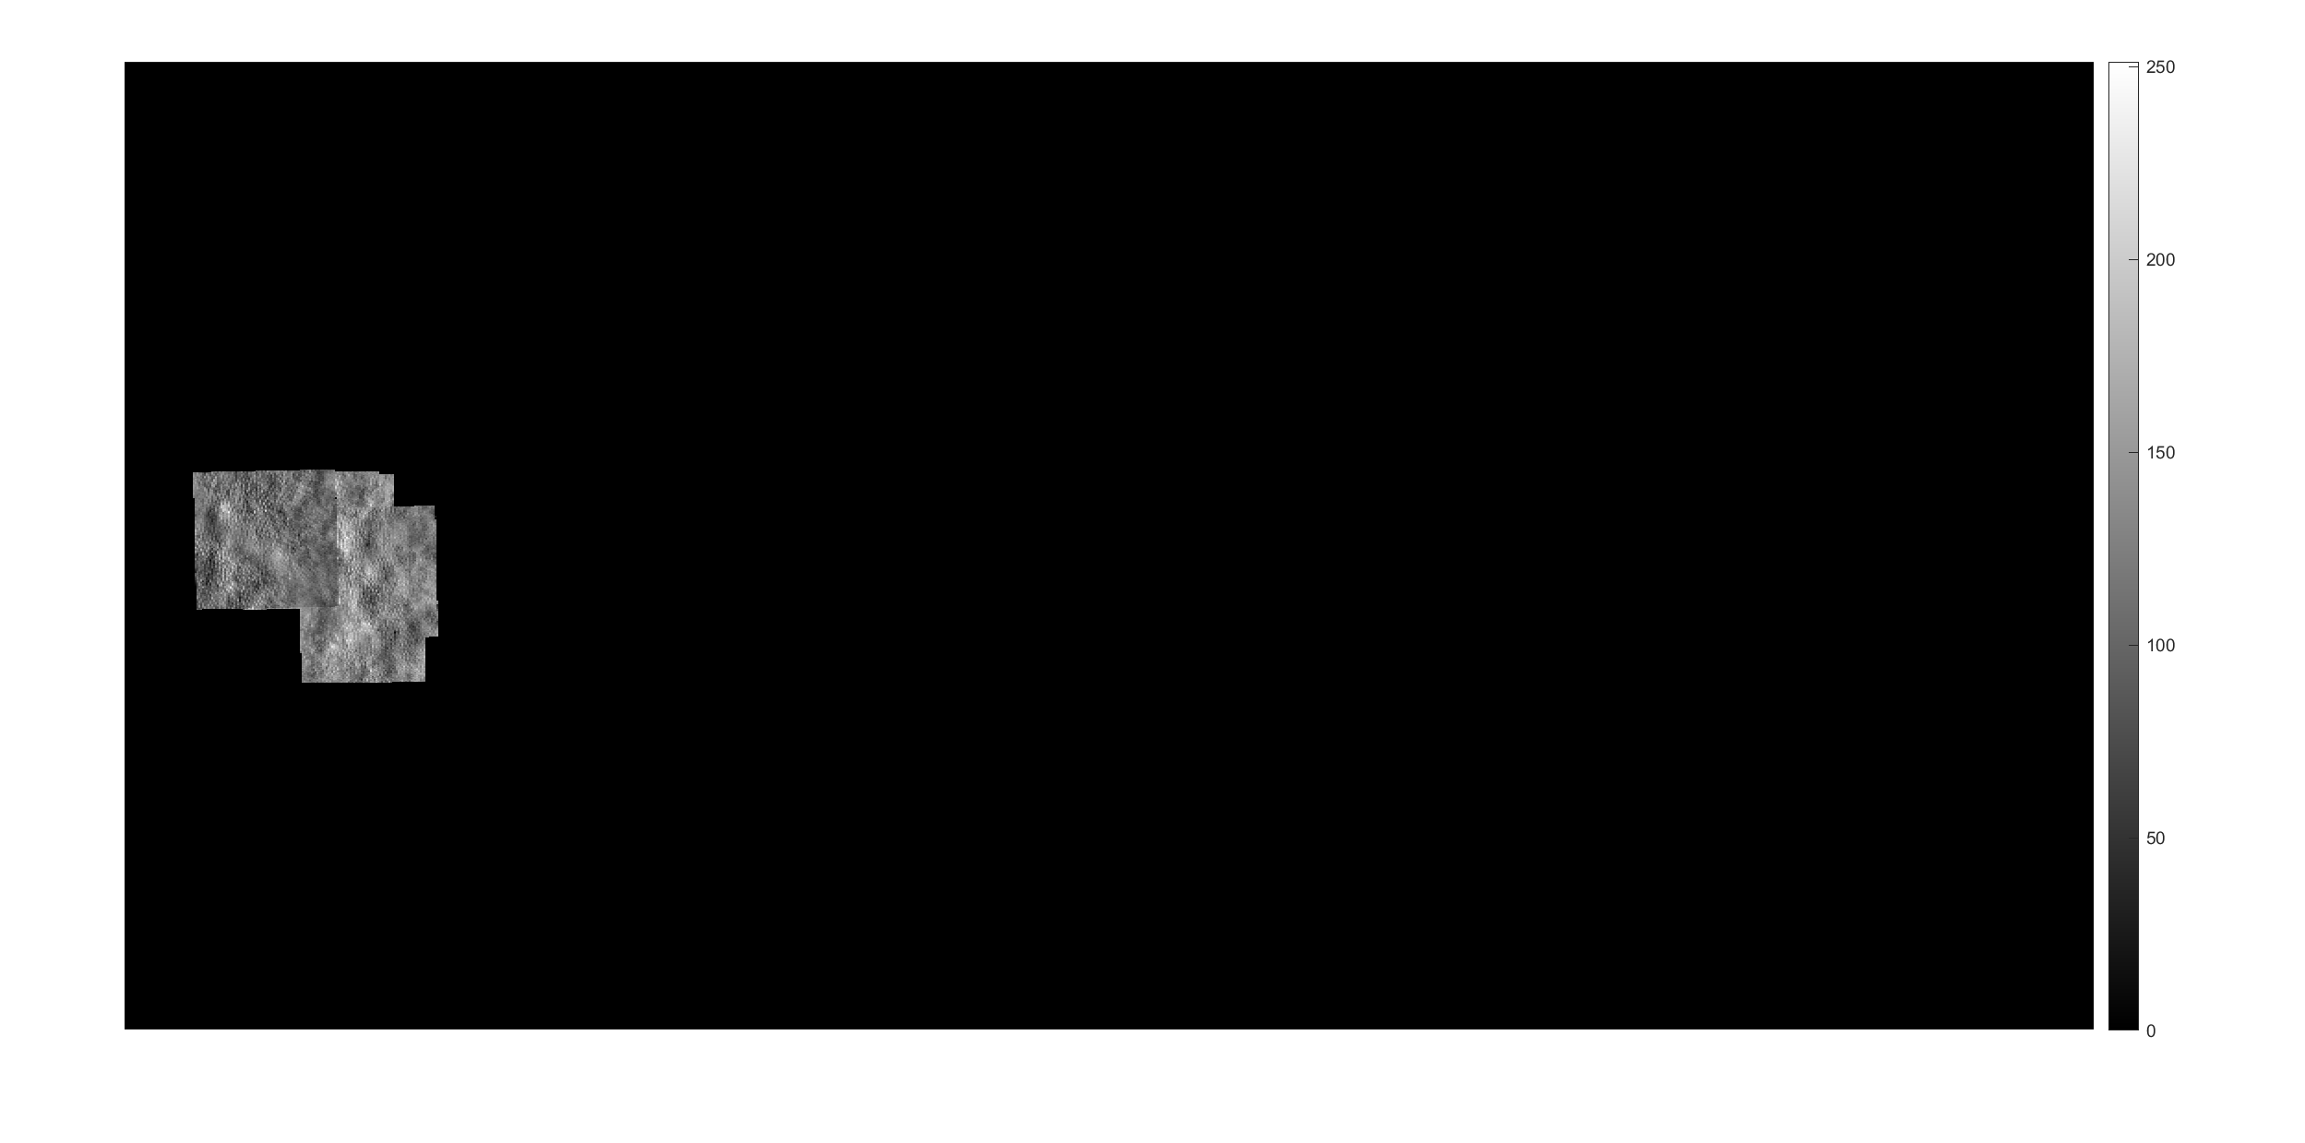
Seed 1

Slide 11
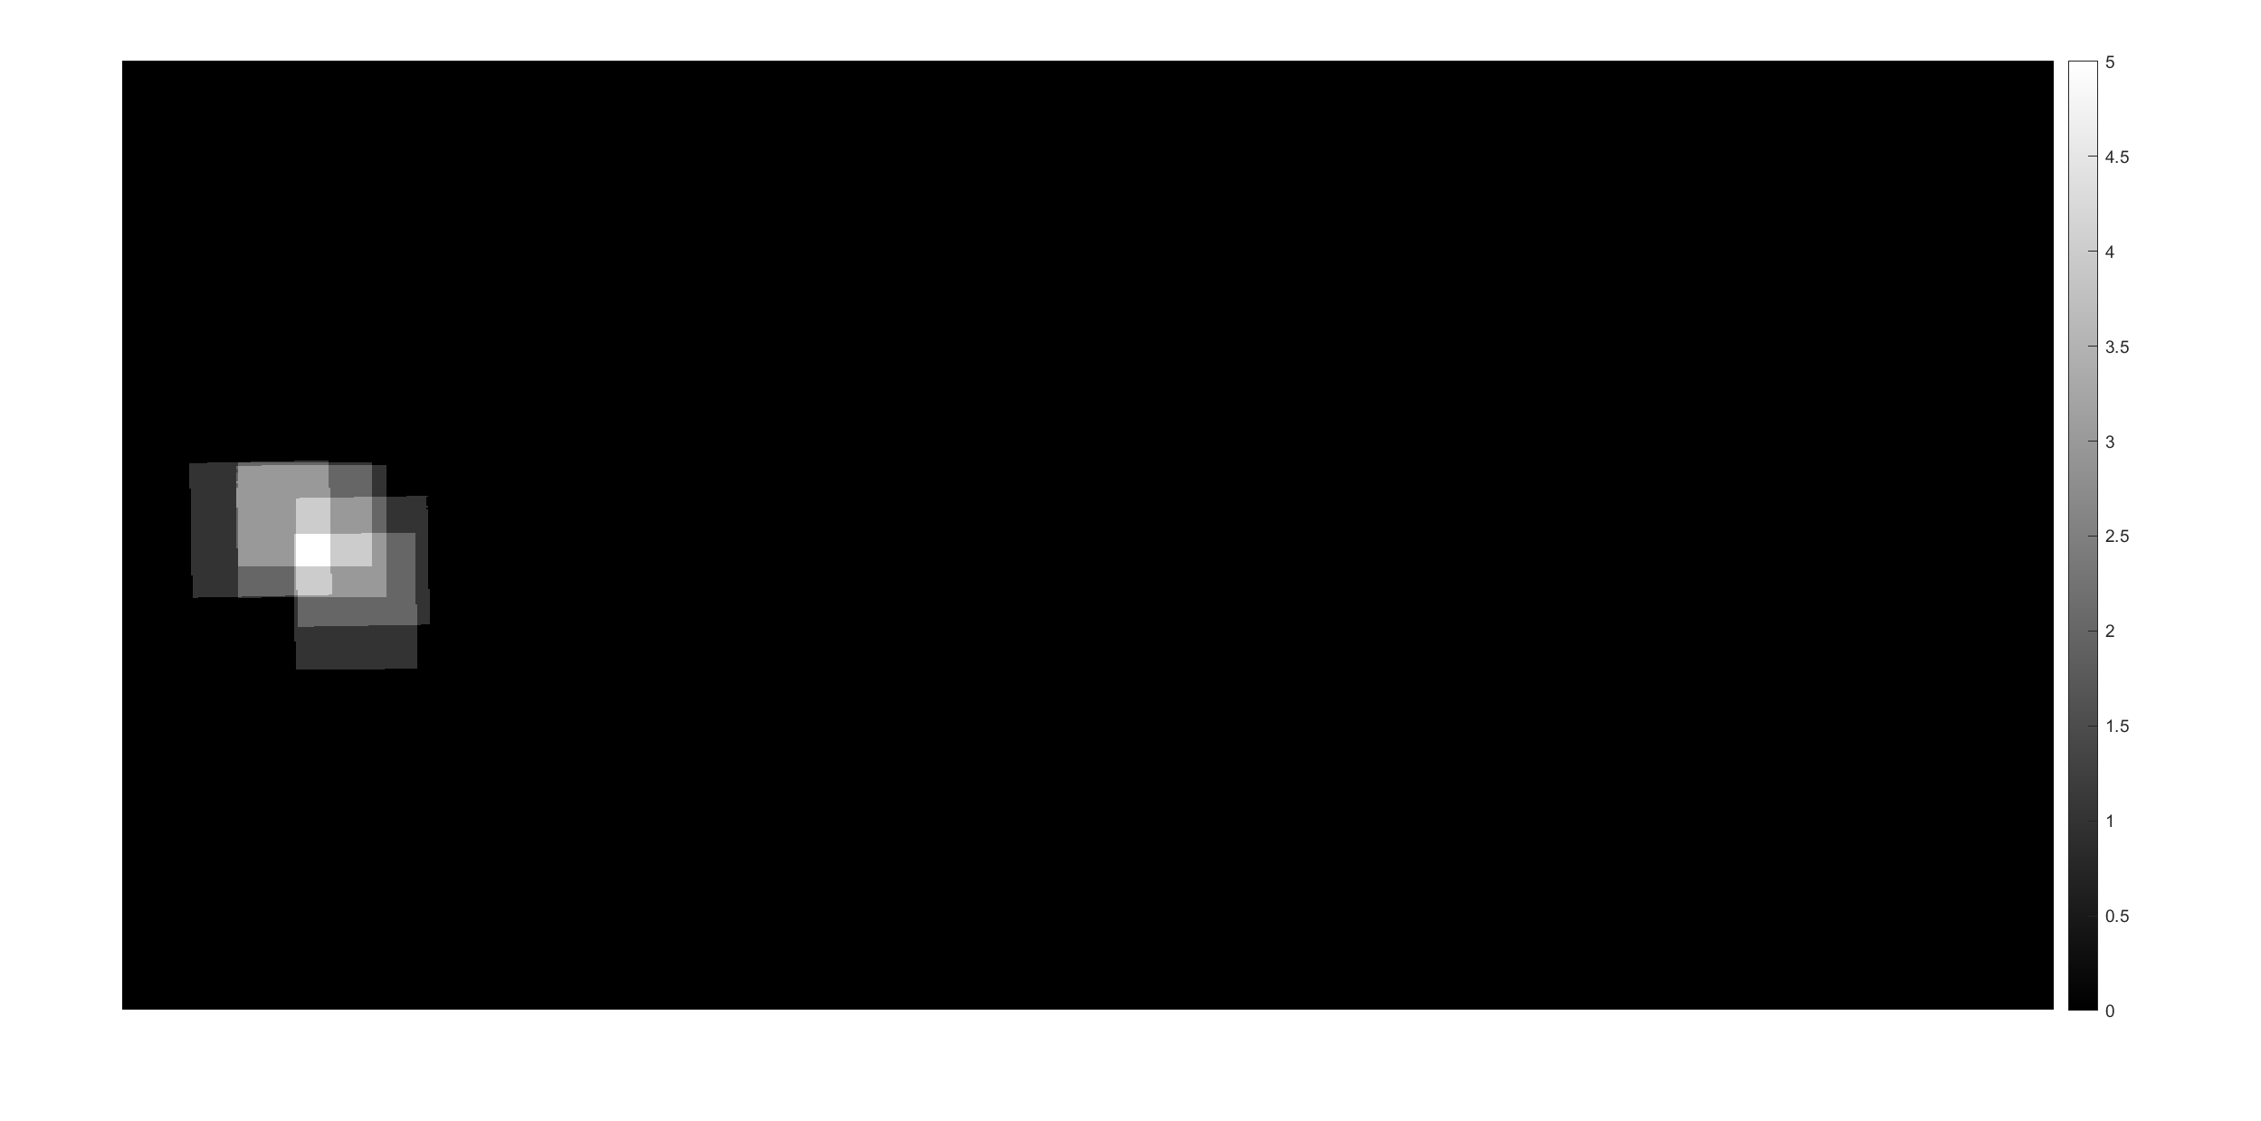
Seed 1 Overlap Count

Slide 12
Seed Creation (Using connected components)

Slide 13
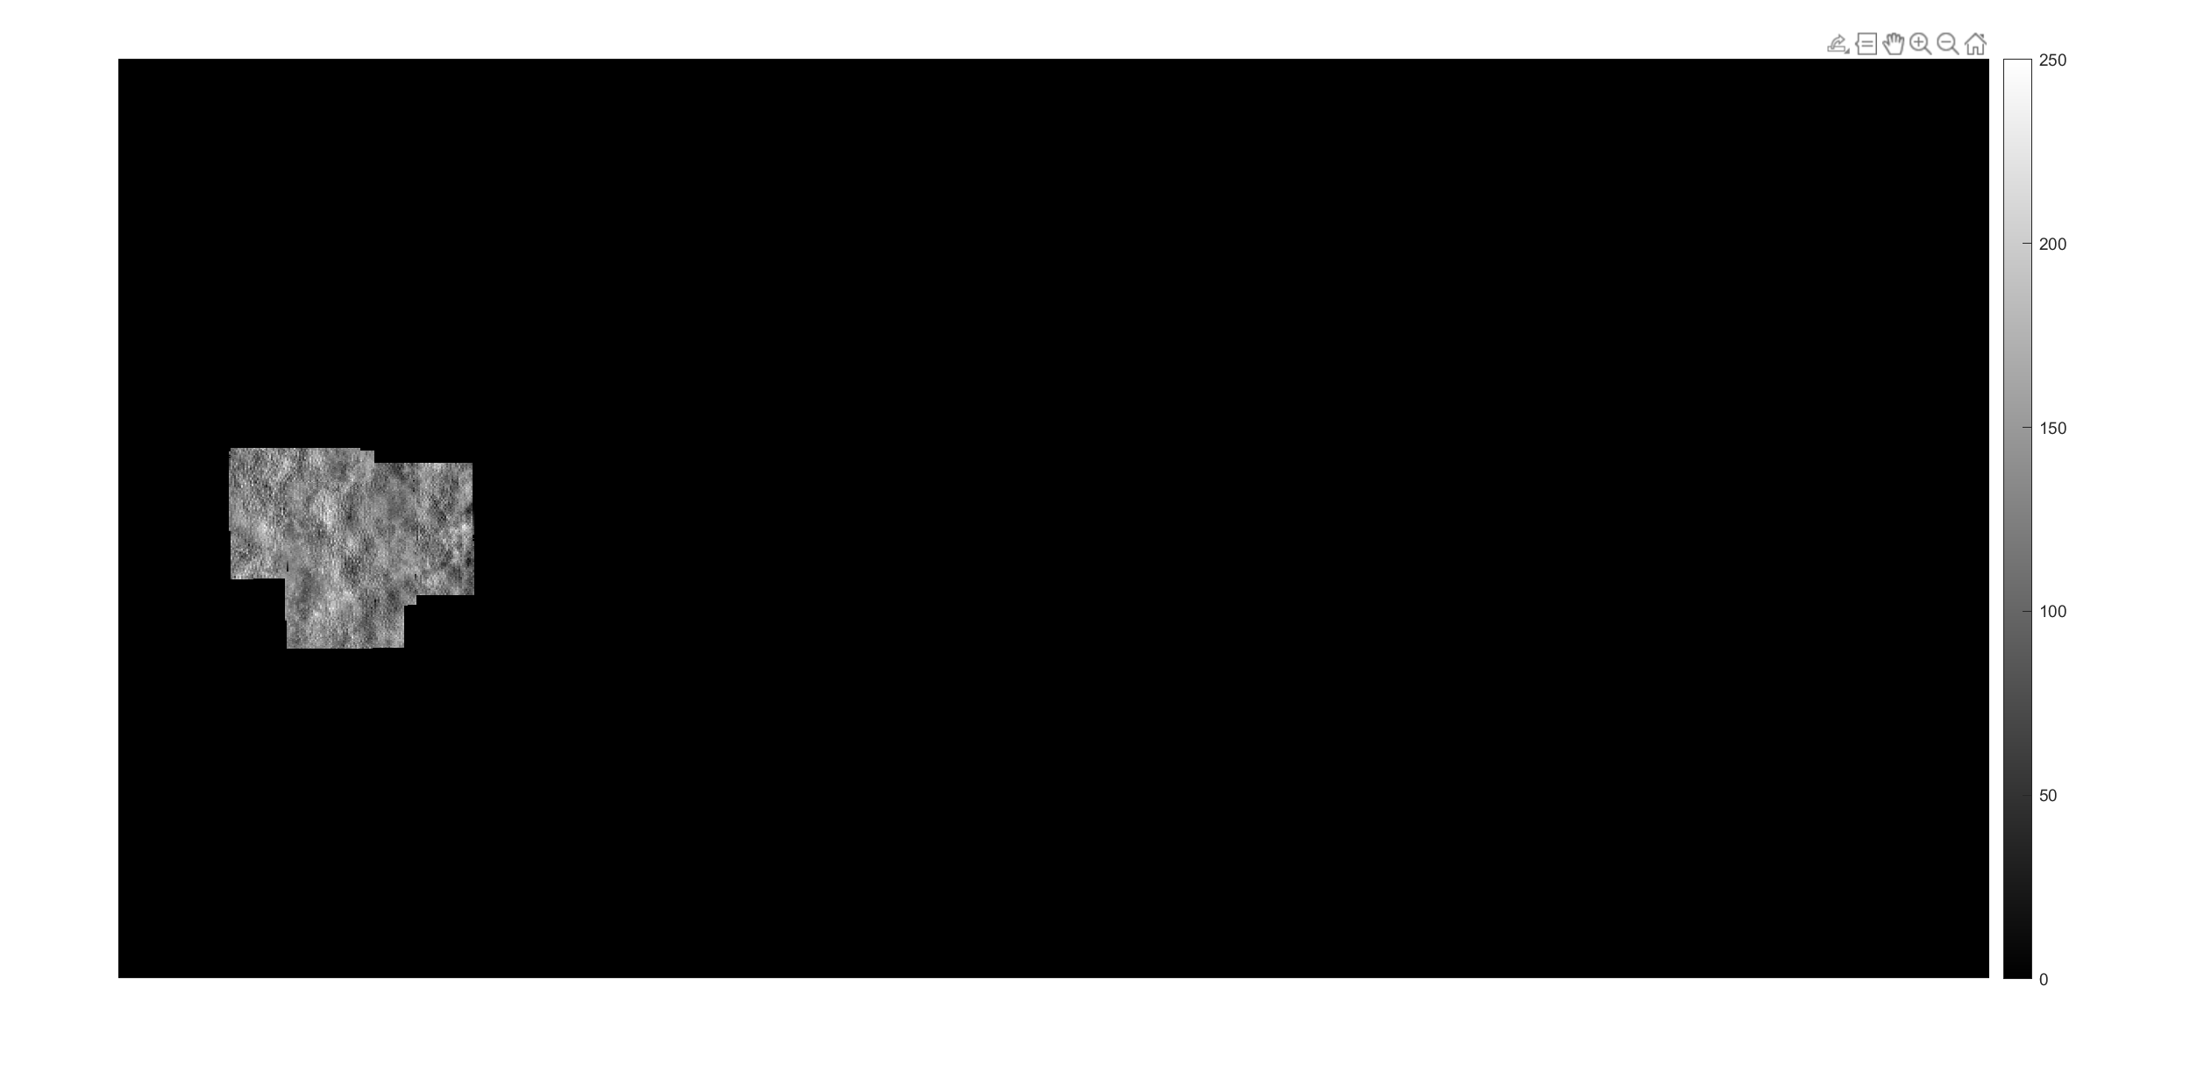
Seed 2

Slide 14
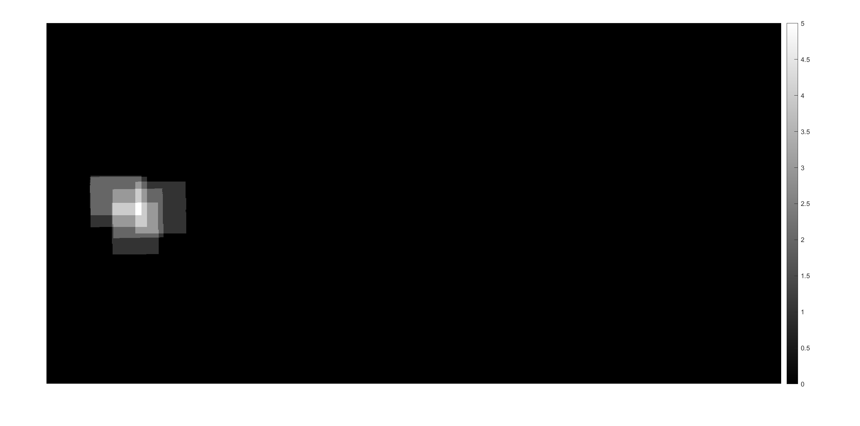
Seed 2 Overlap Count

Slide 15
Seed 1 - Exclusive

Slide 16
Seed 1 – Exclusive Overlap Count

Slide 17
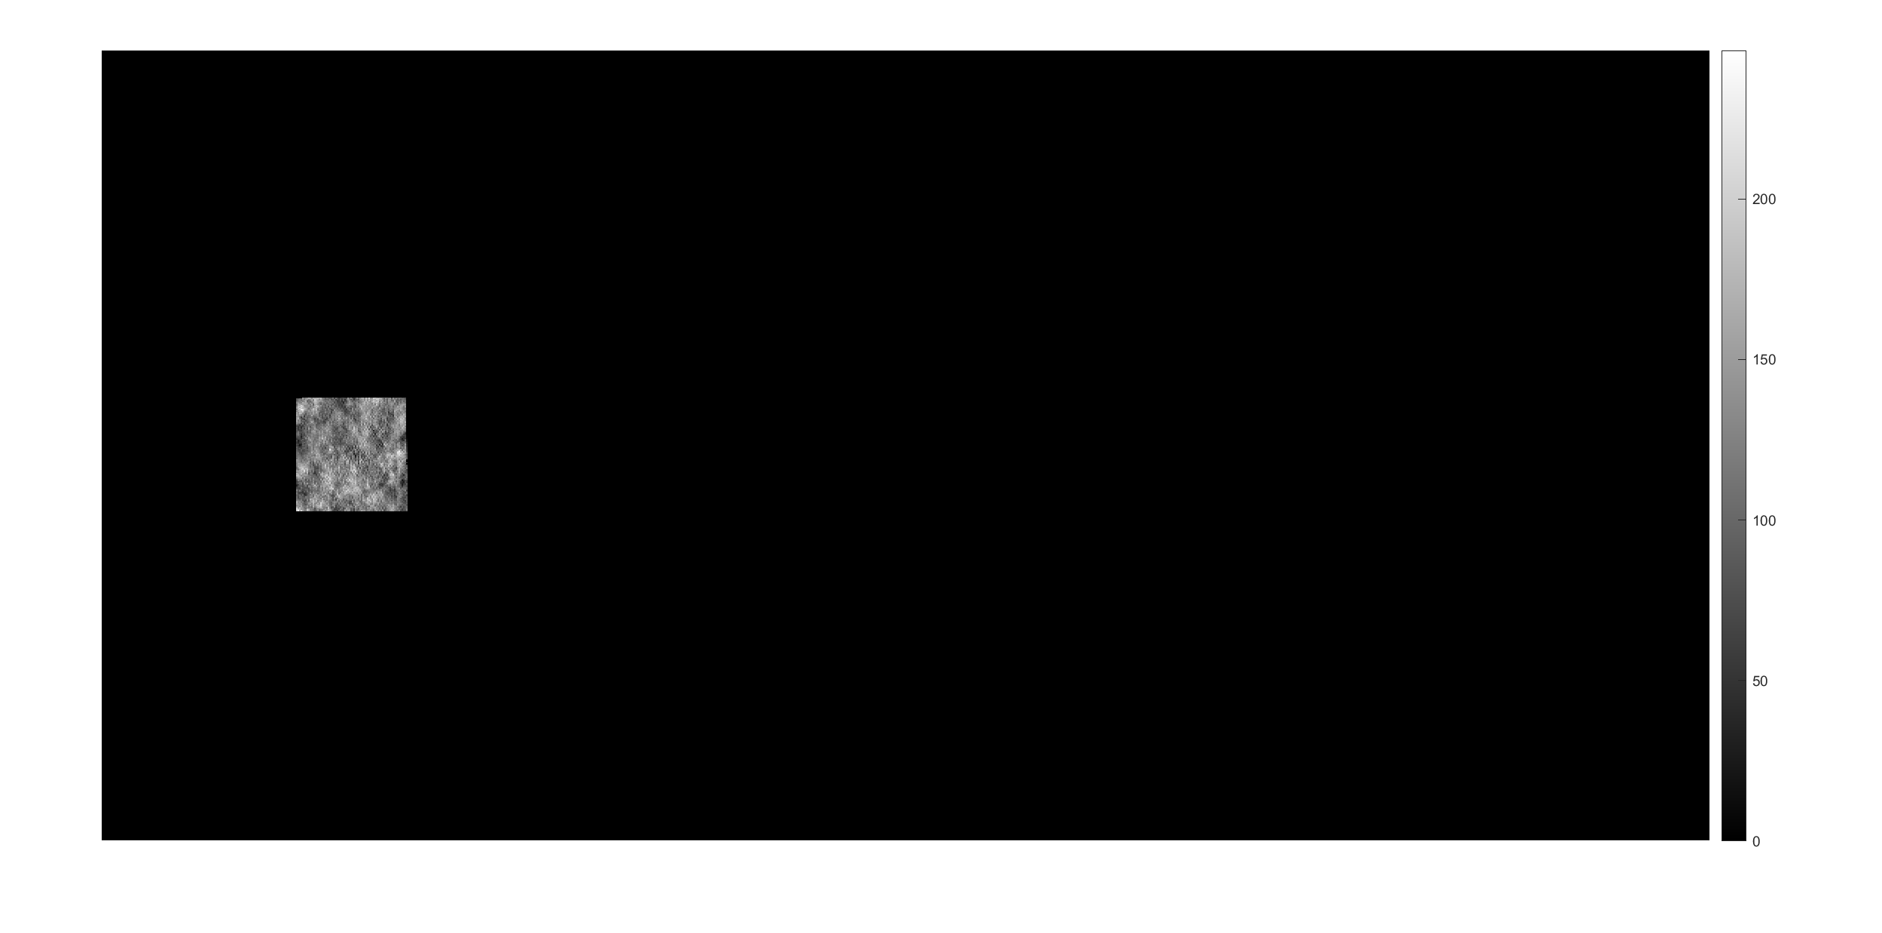
Seed 2 - Exclusive

Slide 18

Seed 1 – Exclusive – Overlap Count

Slide 19
13031_20160728_OS

Slide 22
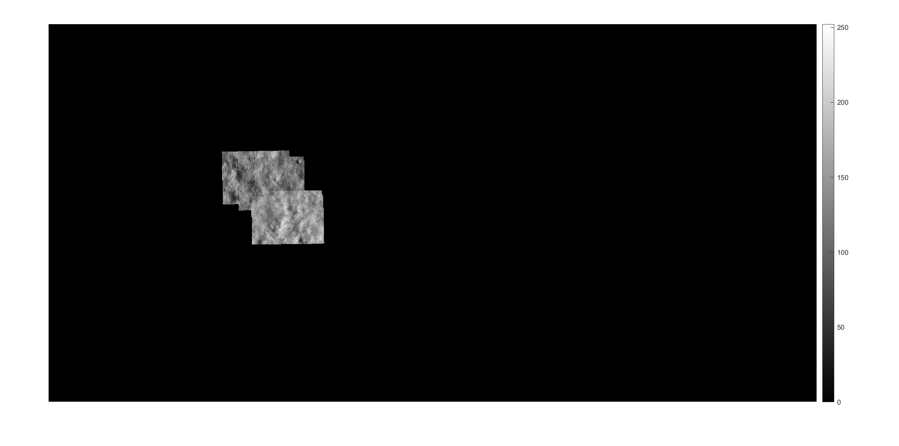

Slide 23
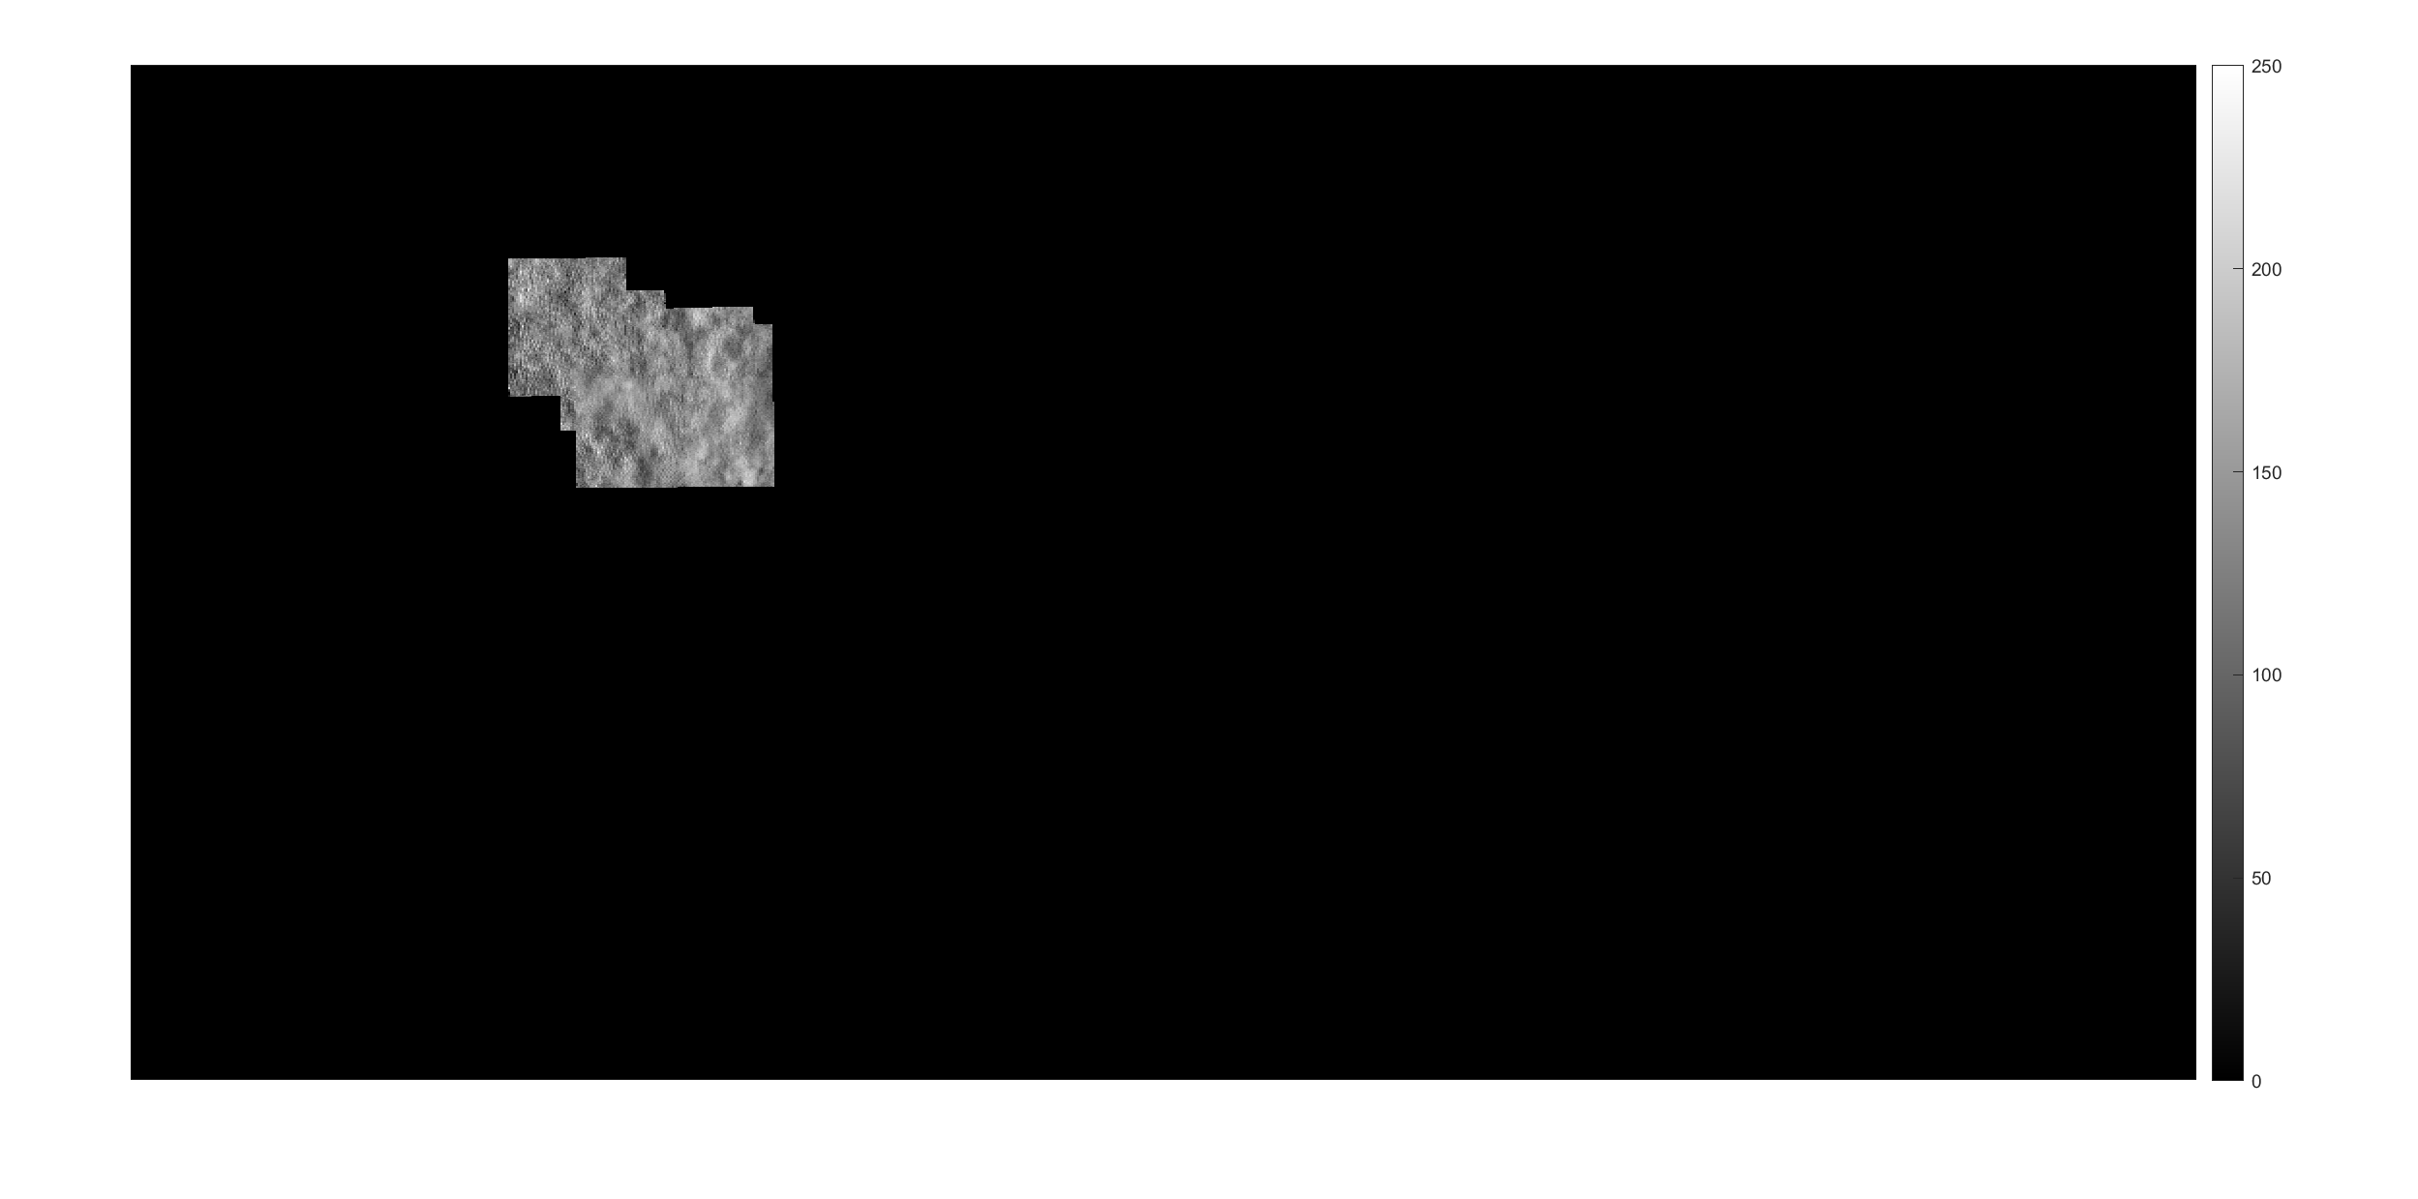

Slide 24
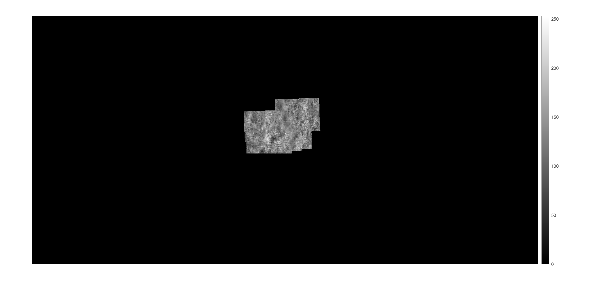

Slide 25
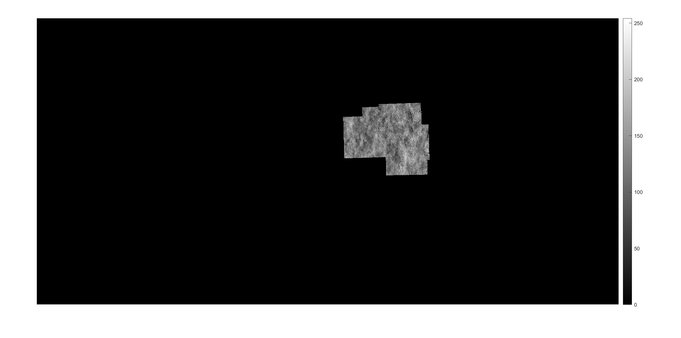

Slide 26
13048_20190722_OS

Slide 28
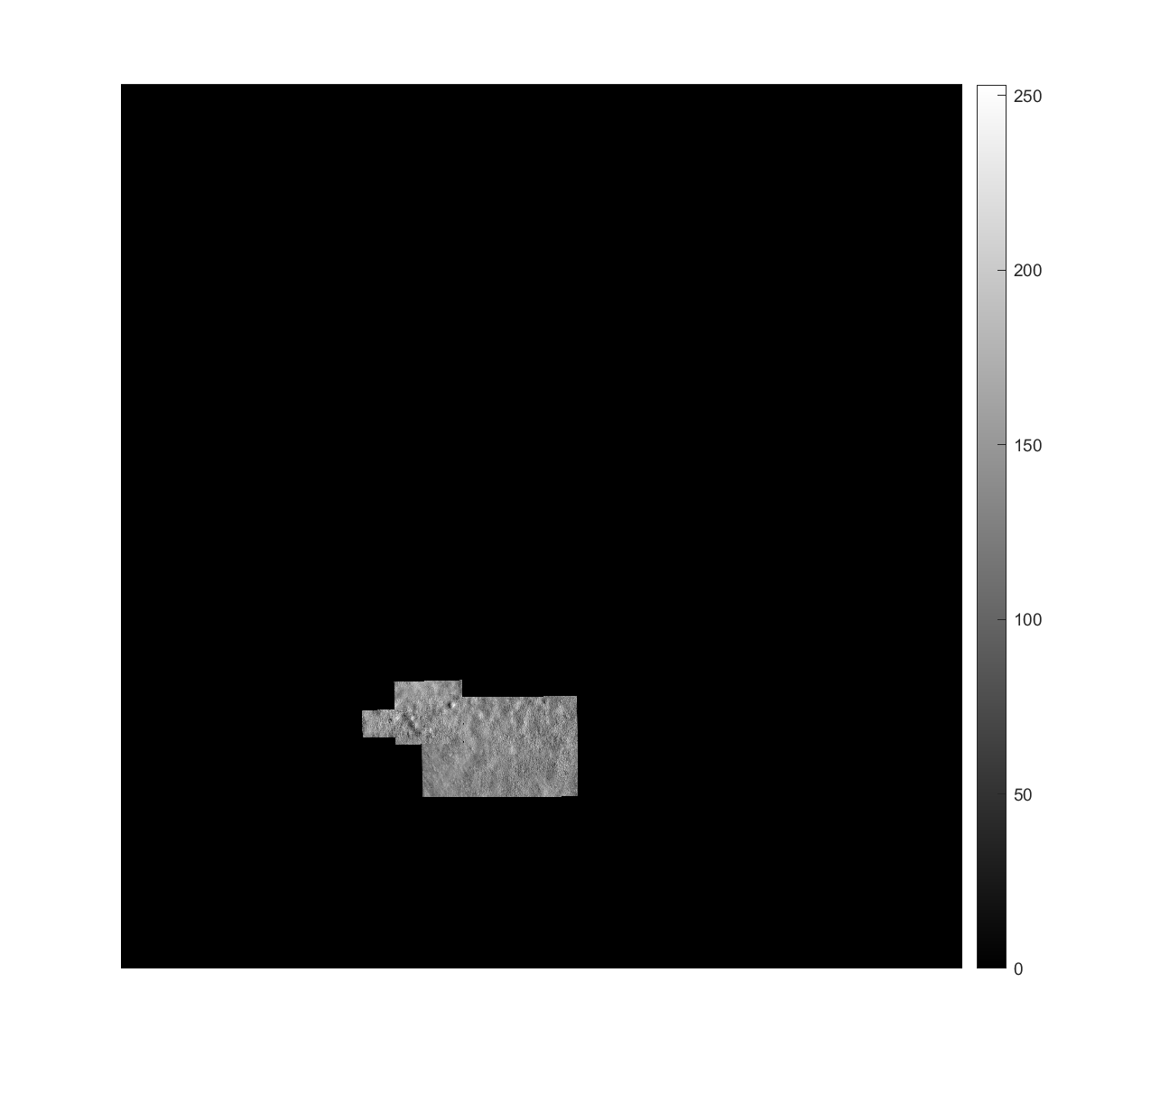

Slide 29
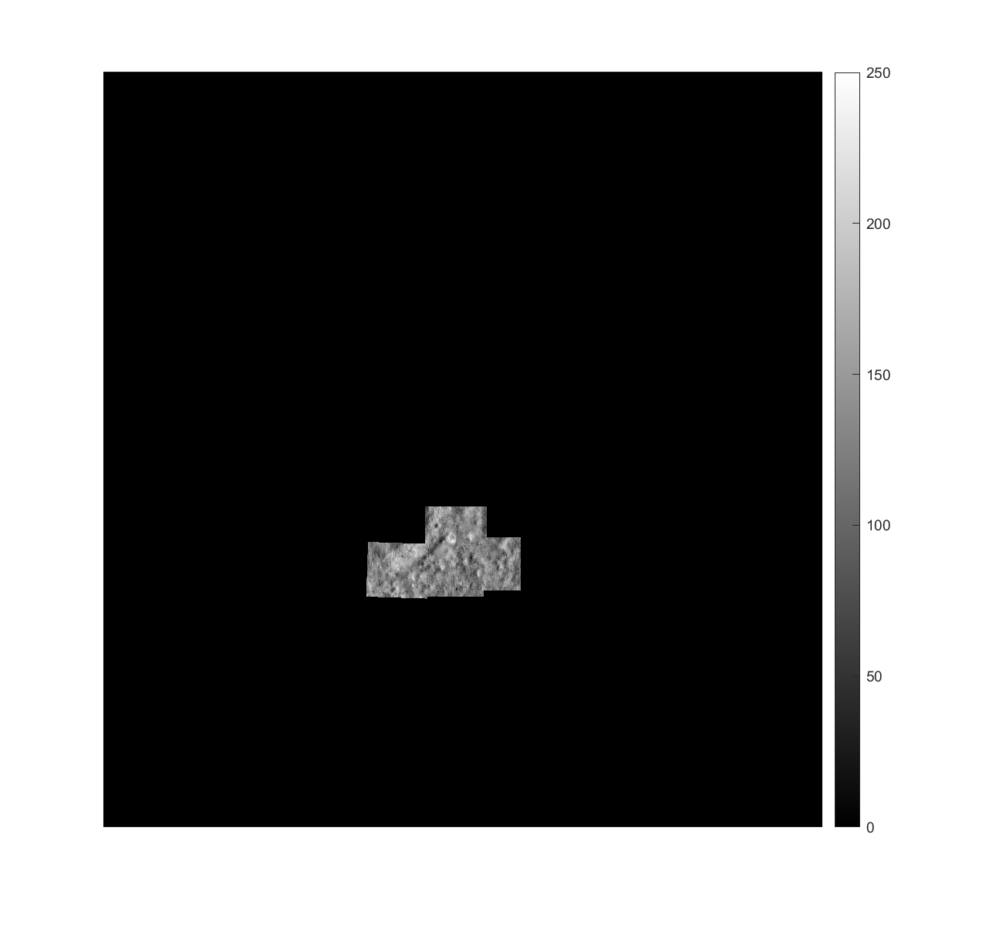

Slide 30
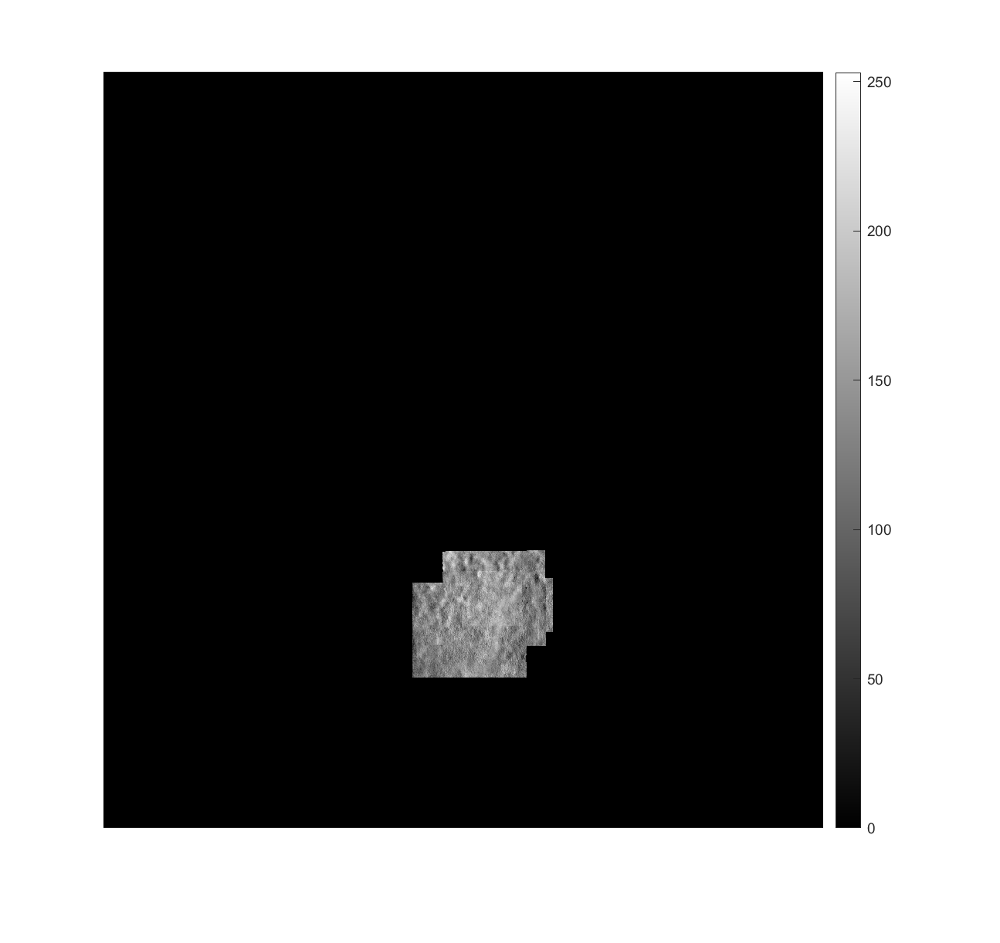

Slide 31
13122_20160519_OS

Slide 33
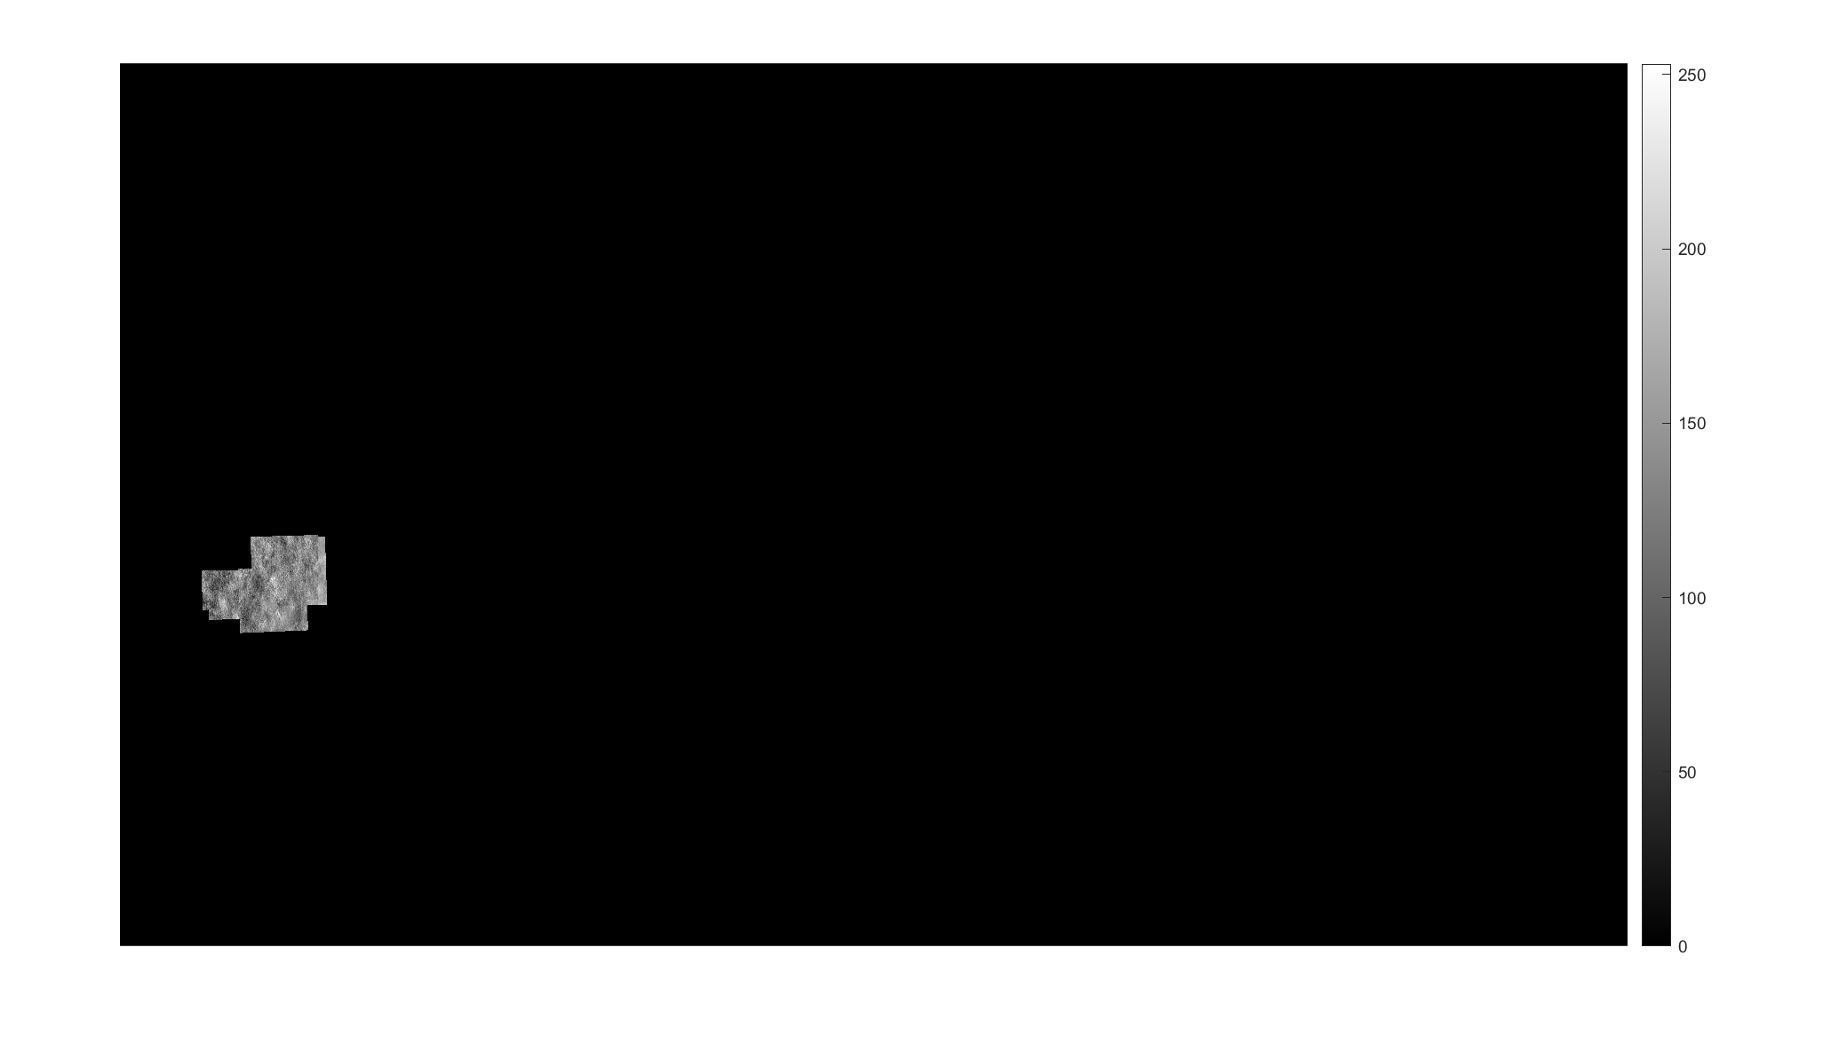

Slide 34
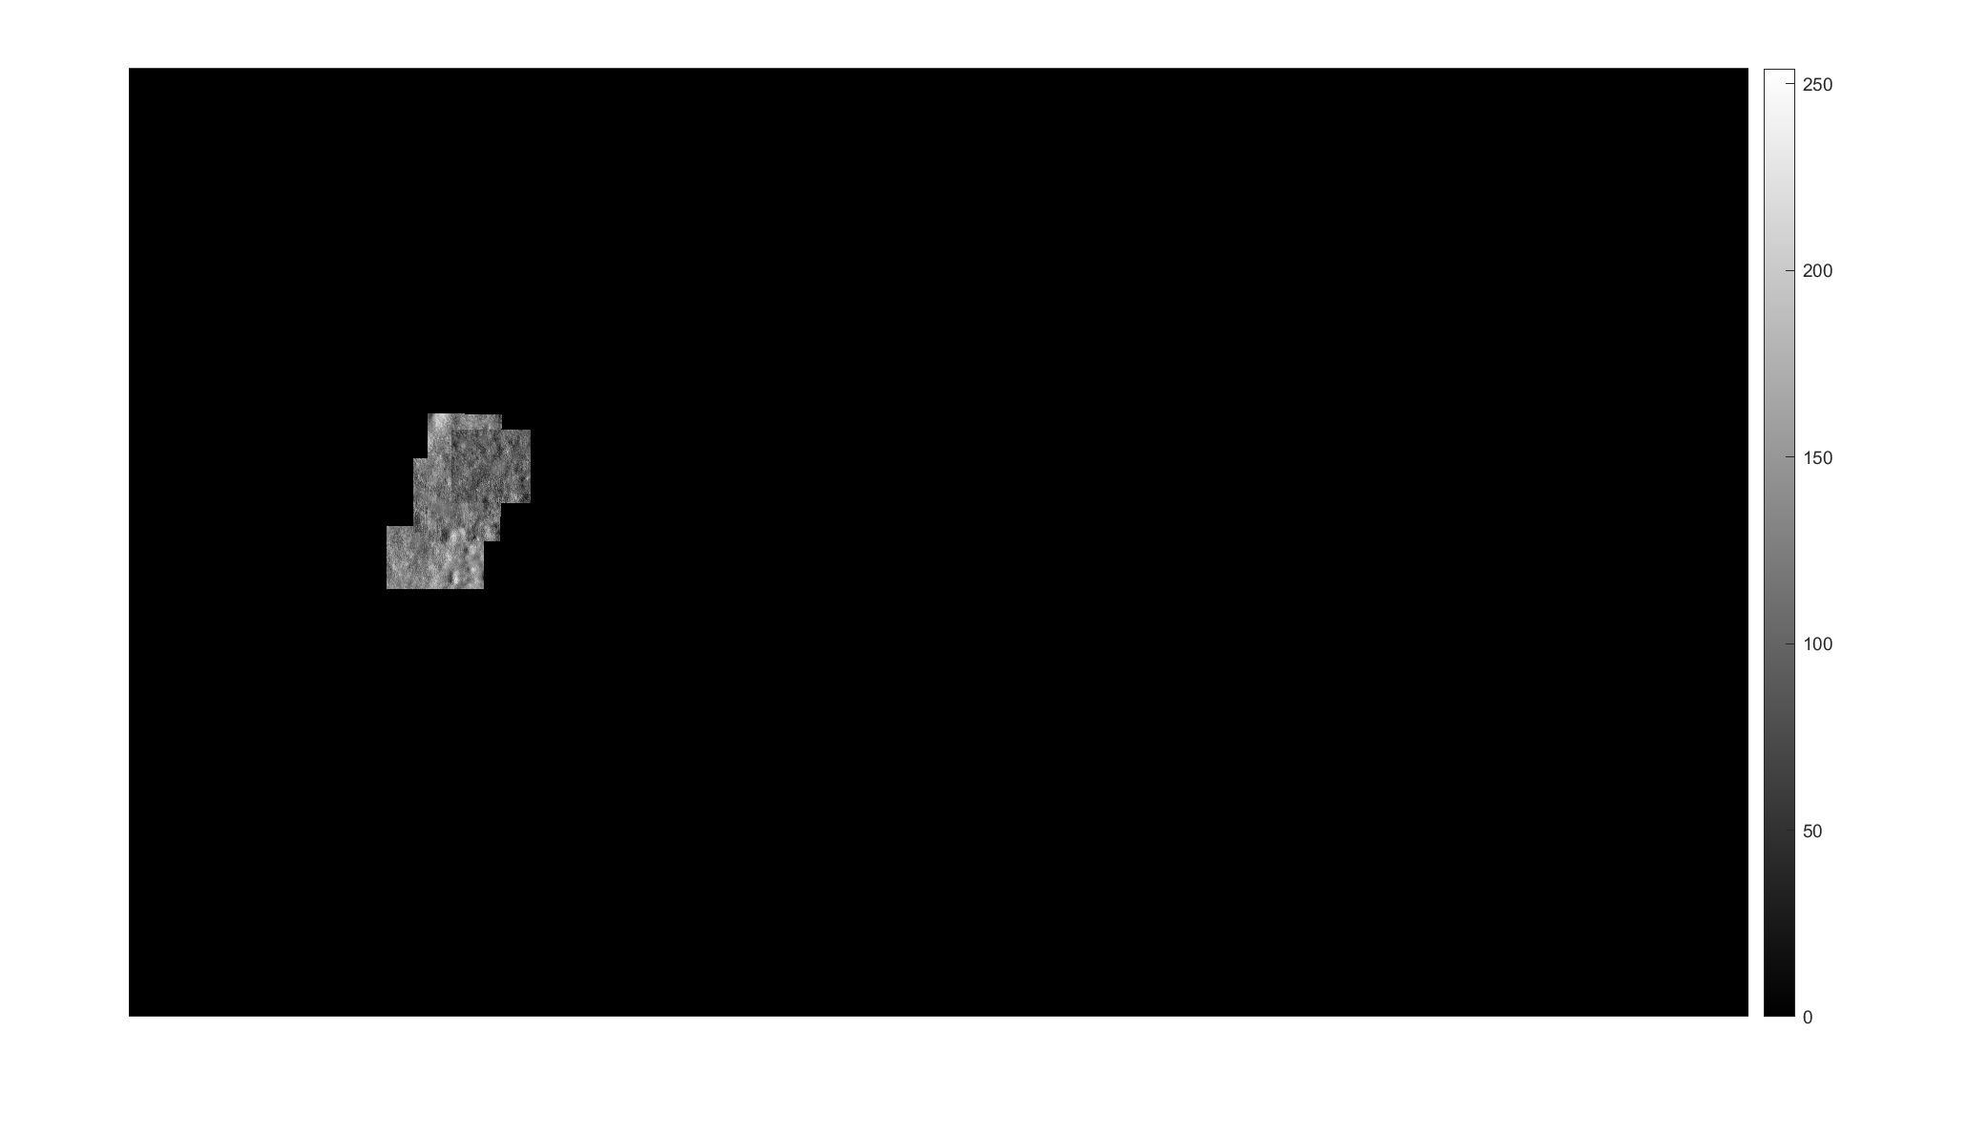

Slide 35
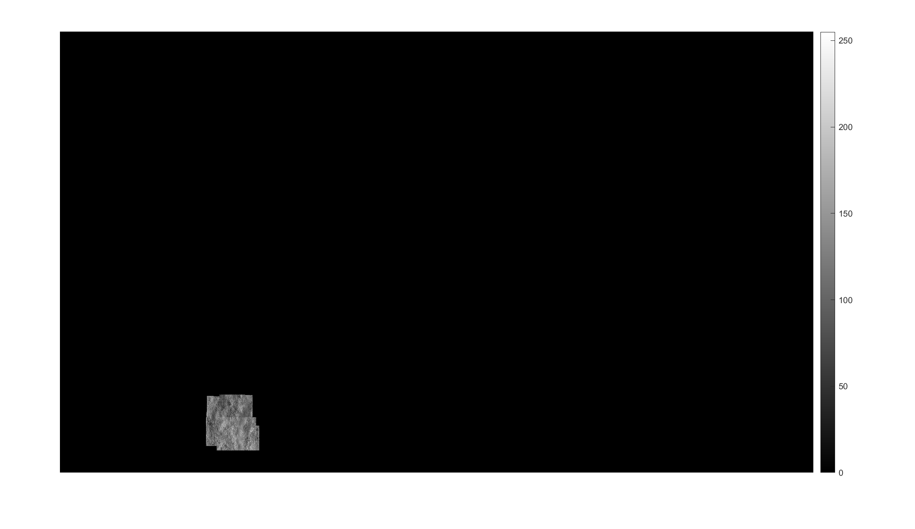

Slide 36
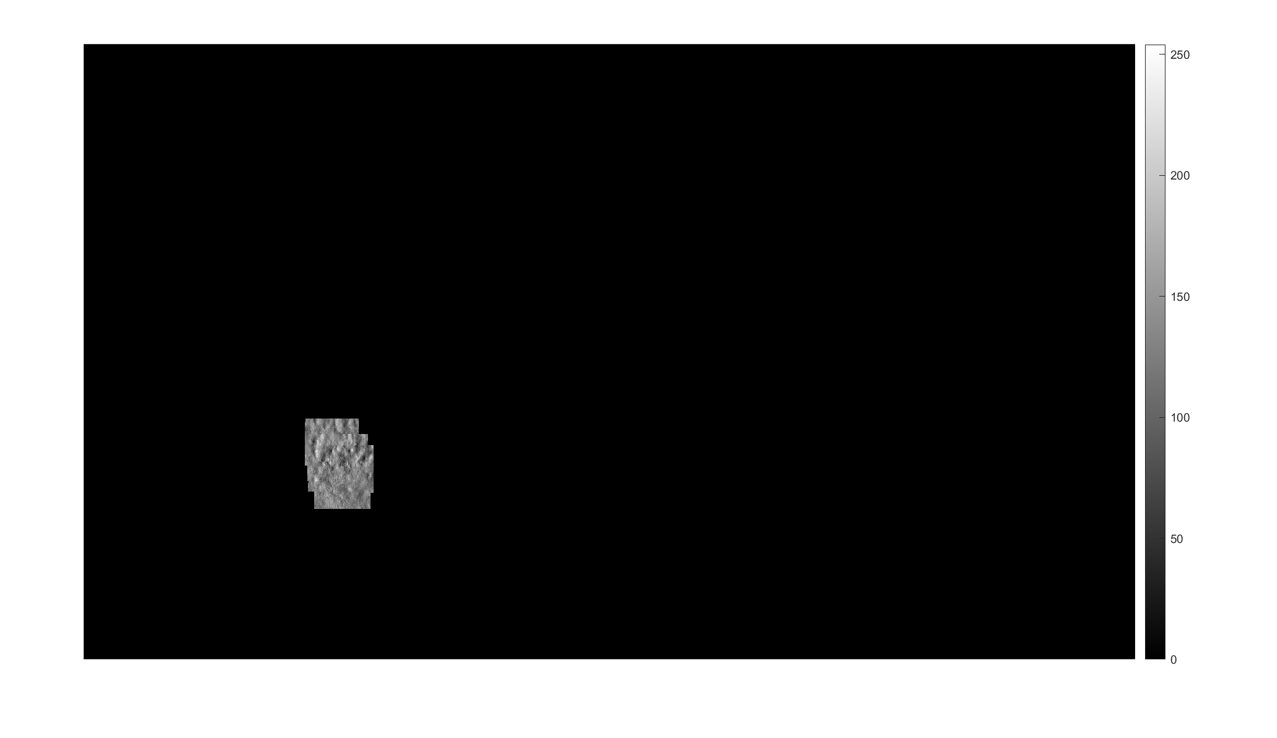

Slide 37
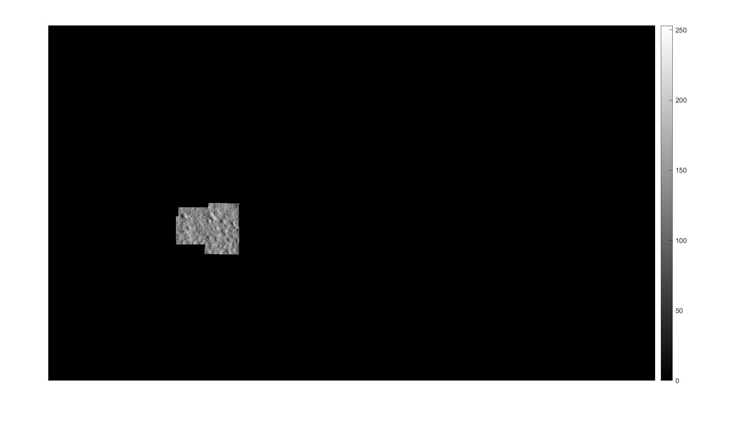

Slide 38
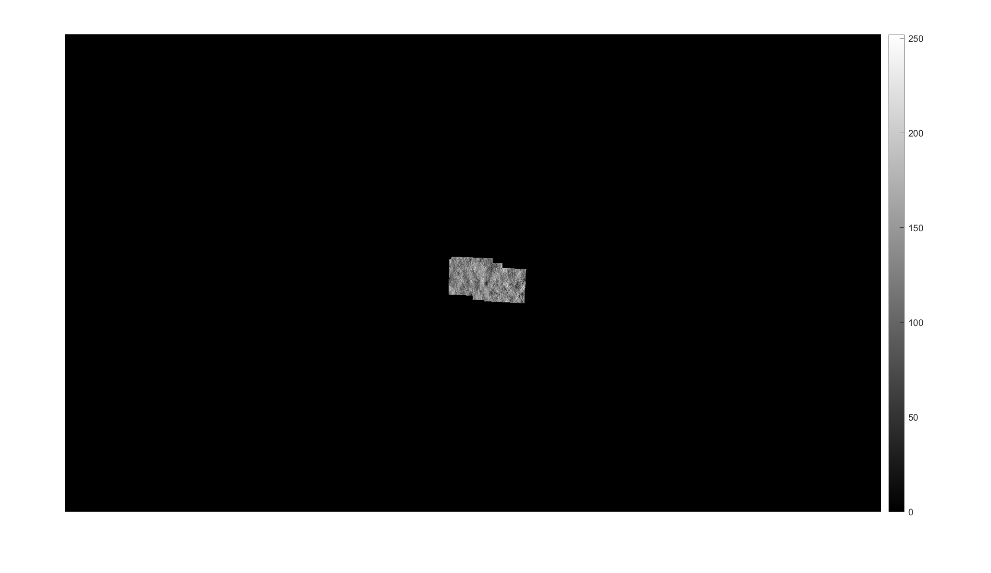

Slide 39
13195_20170920_OD

Slide 41
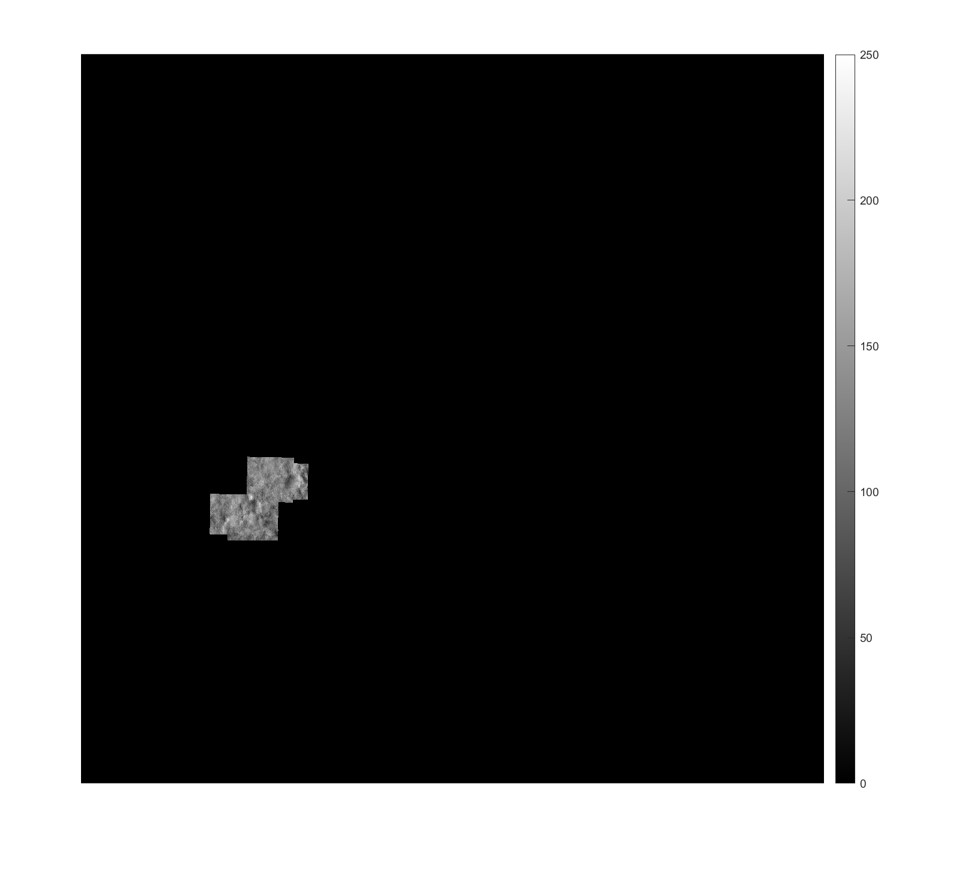

Slide 42
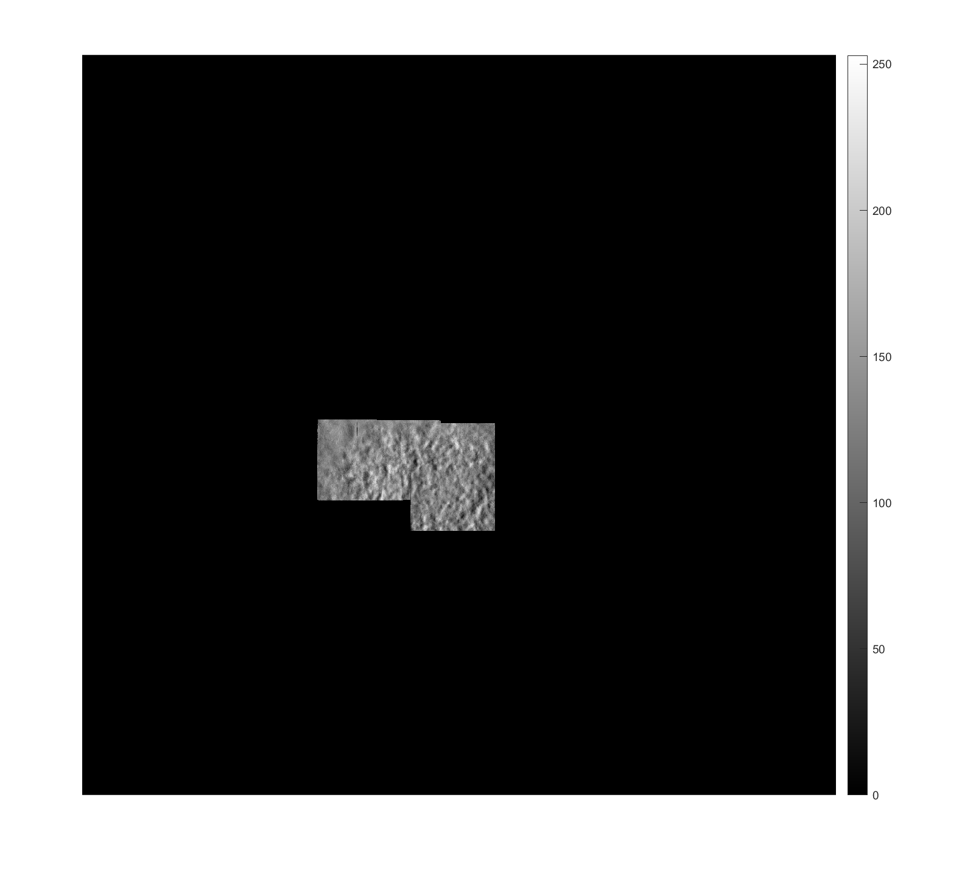

Slide 43
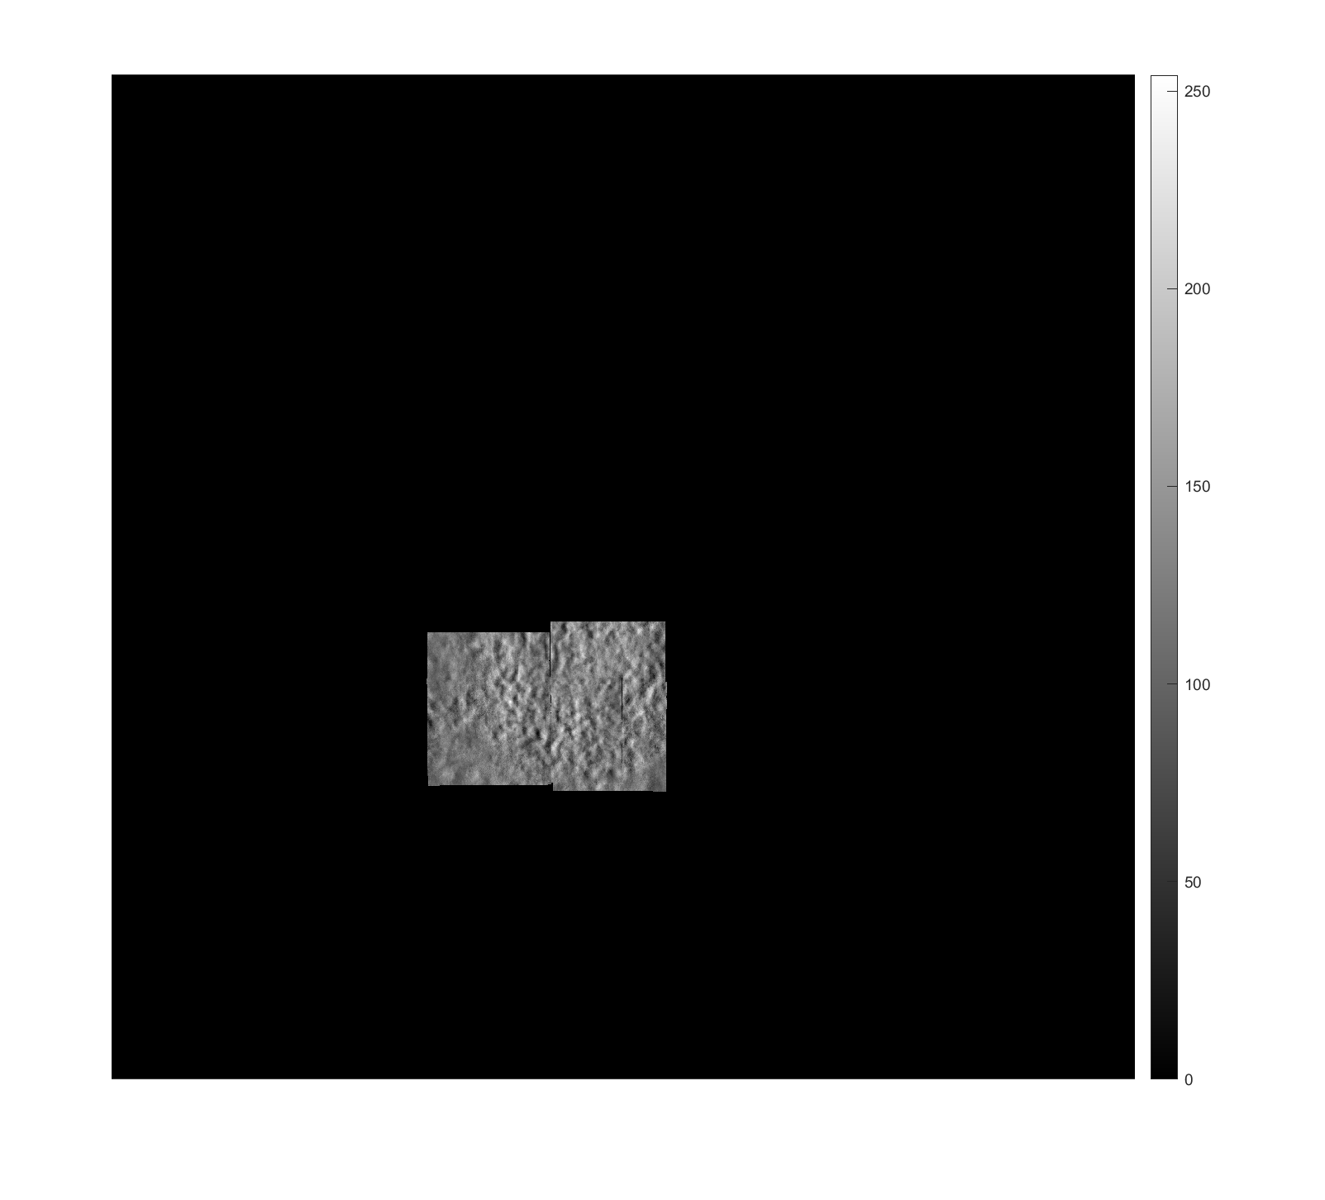

Slide 44
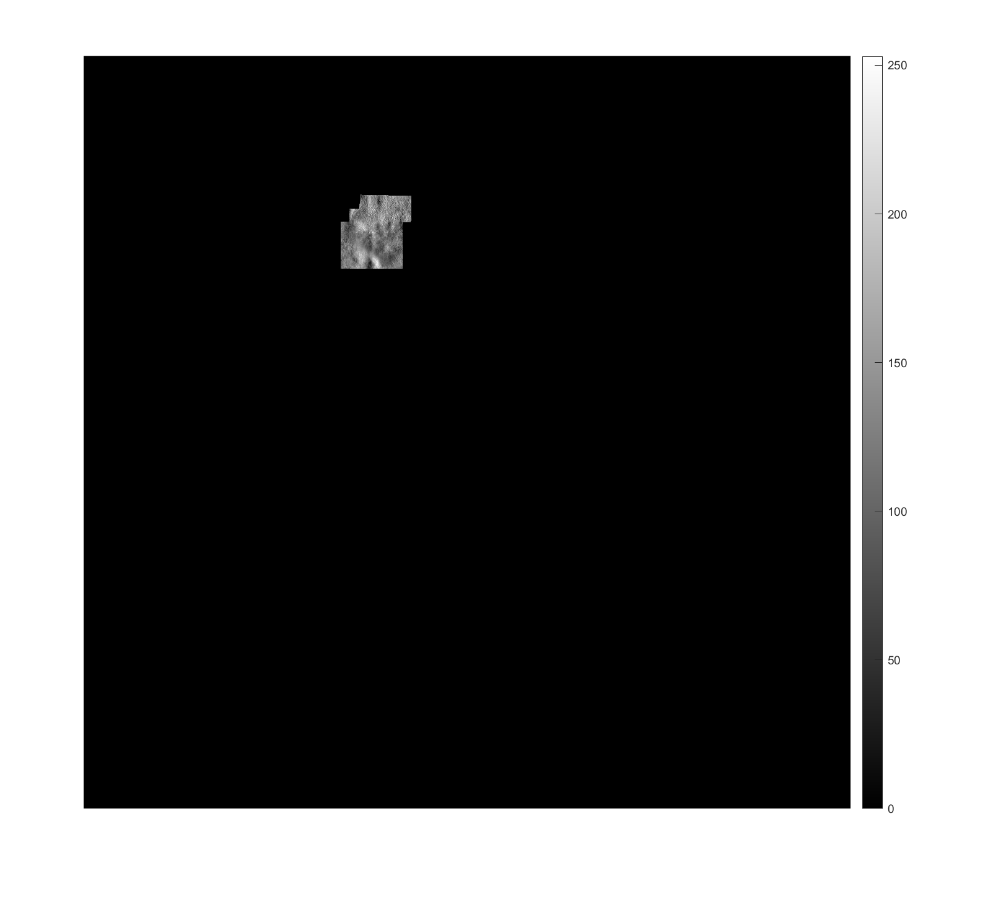

Slide 45
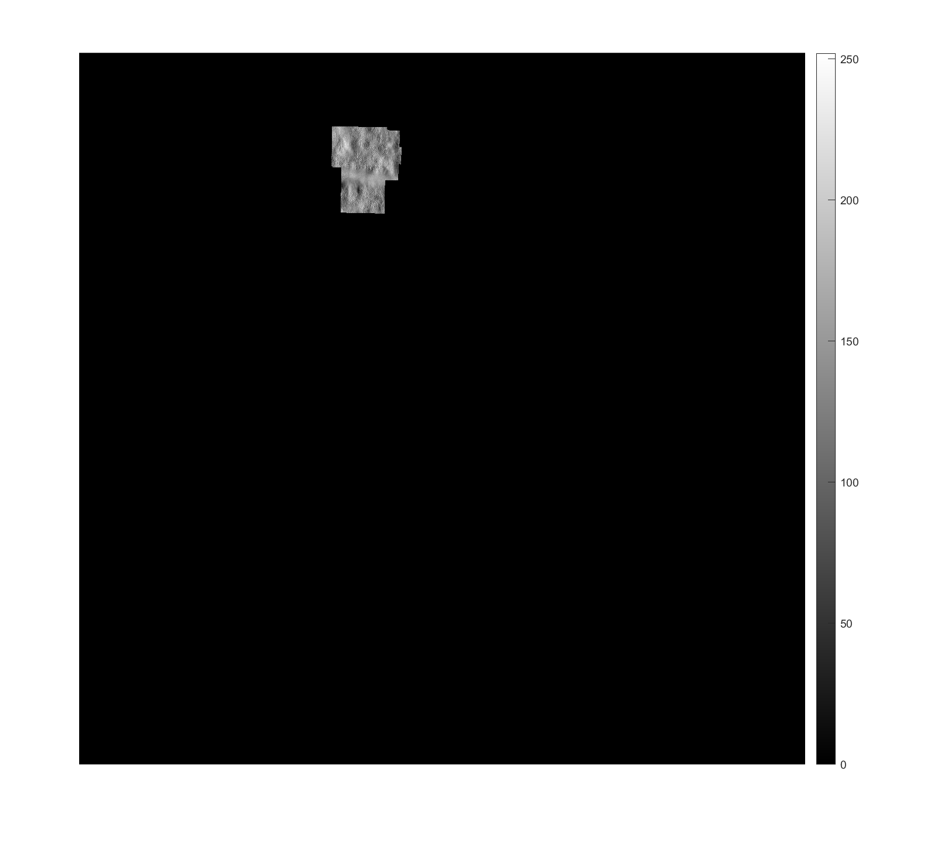

Slide 46
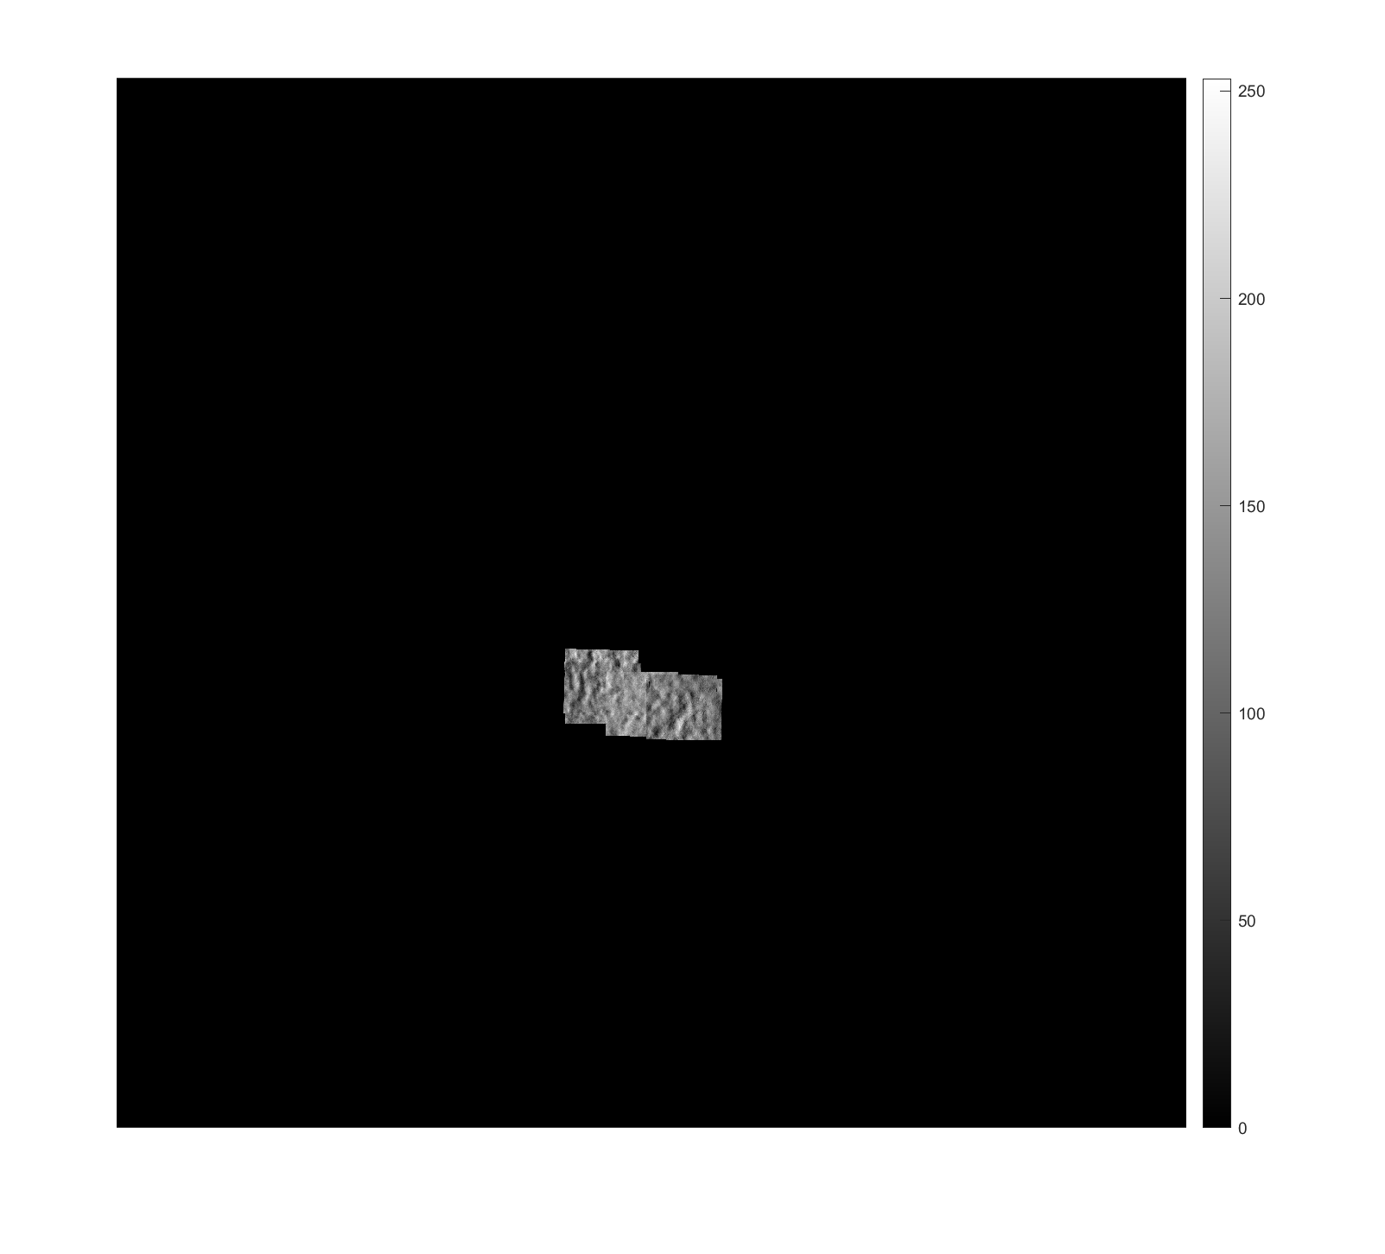

Slide 47
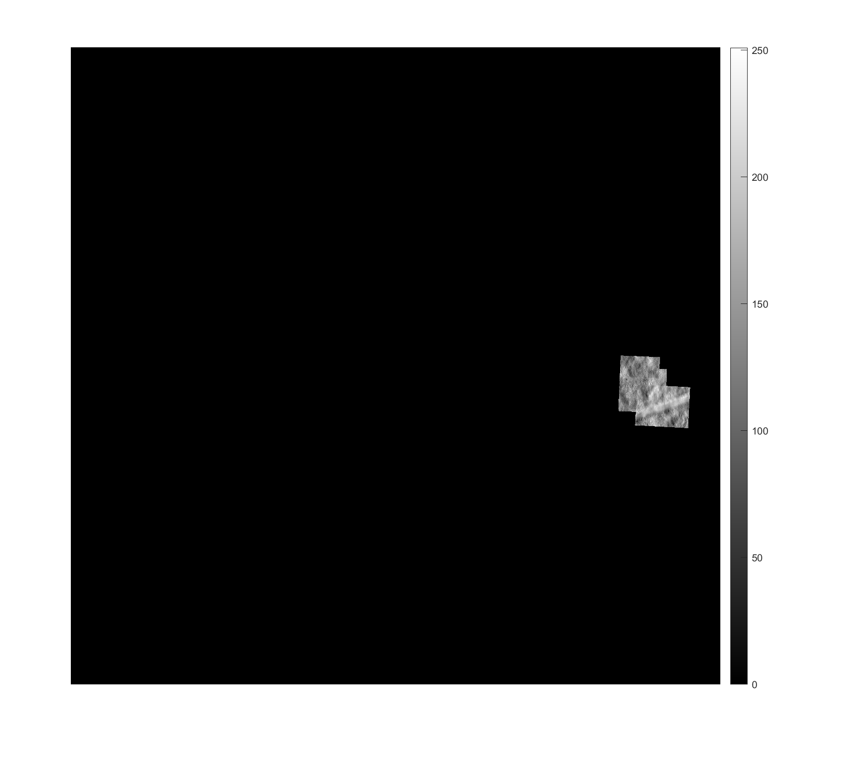

Slide 48
13270_20190730_OD

Slide 50


Slide 51
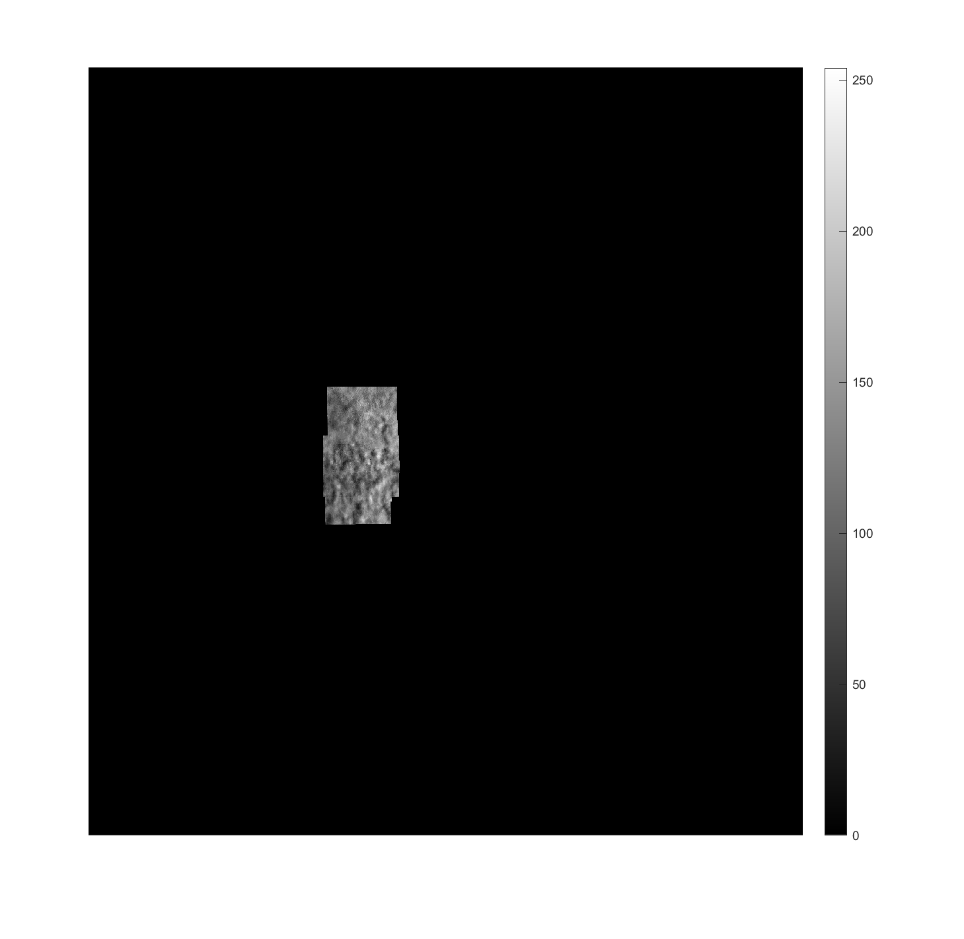

Slide 52
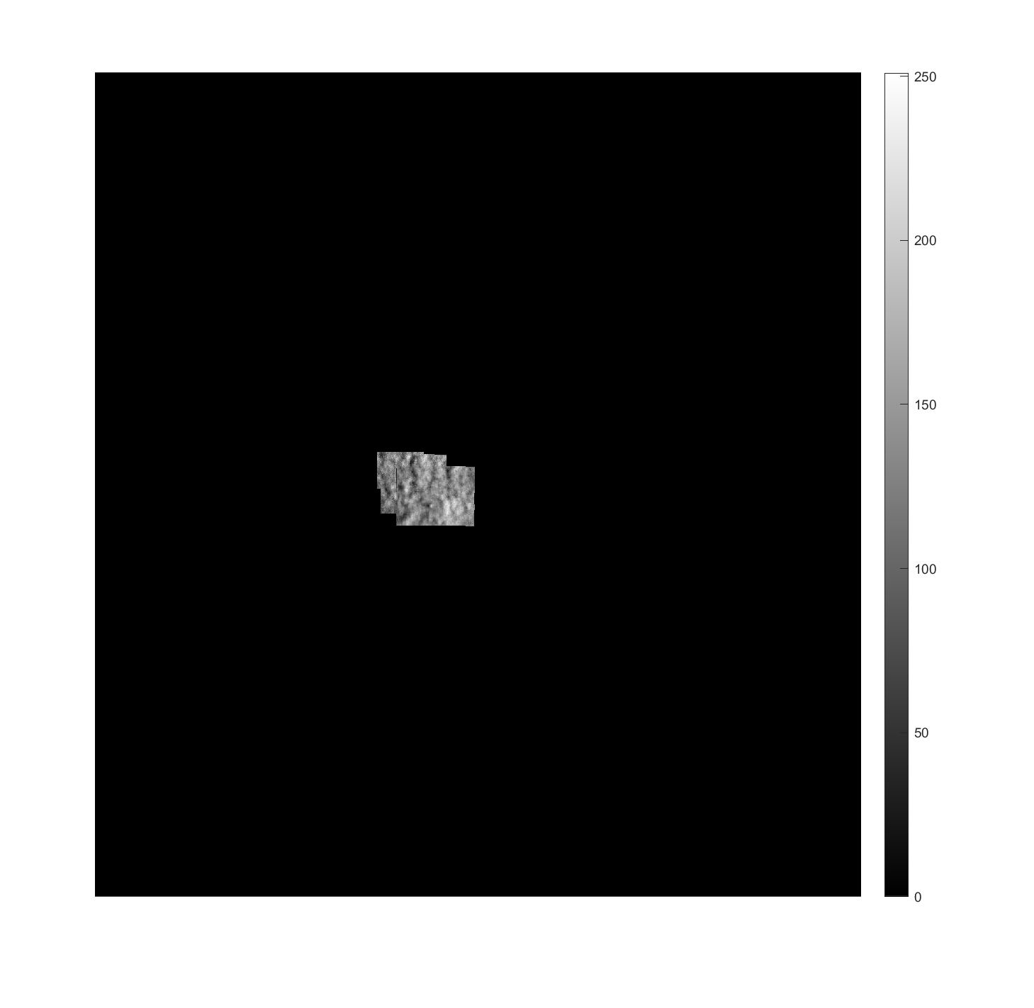

Slide 53
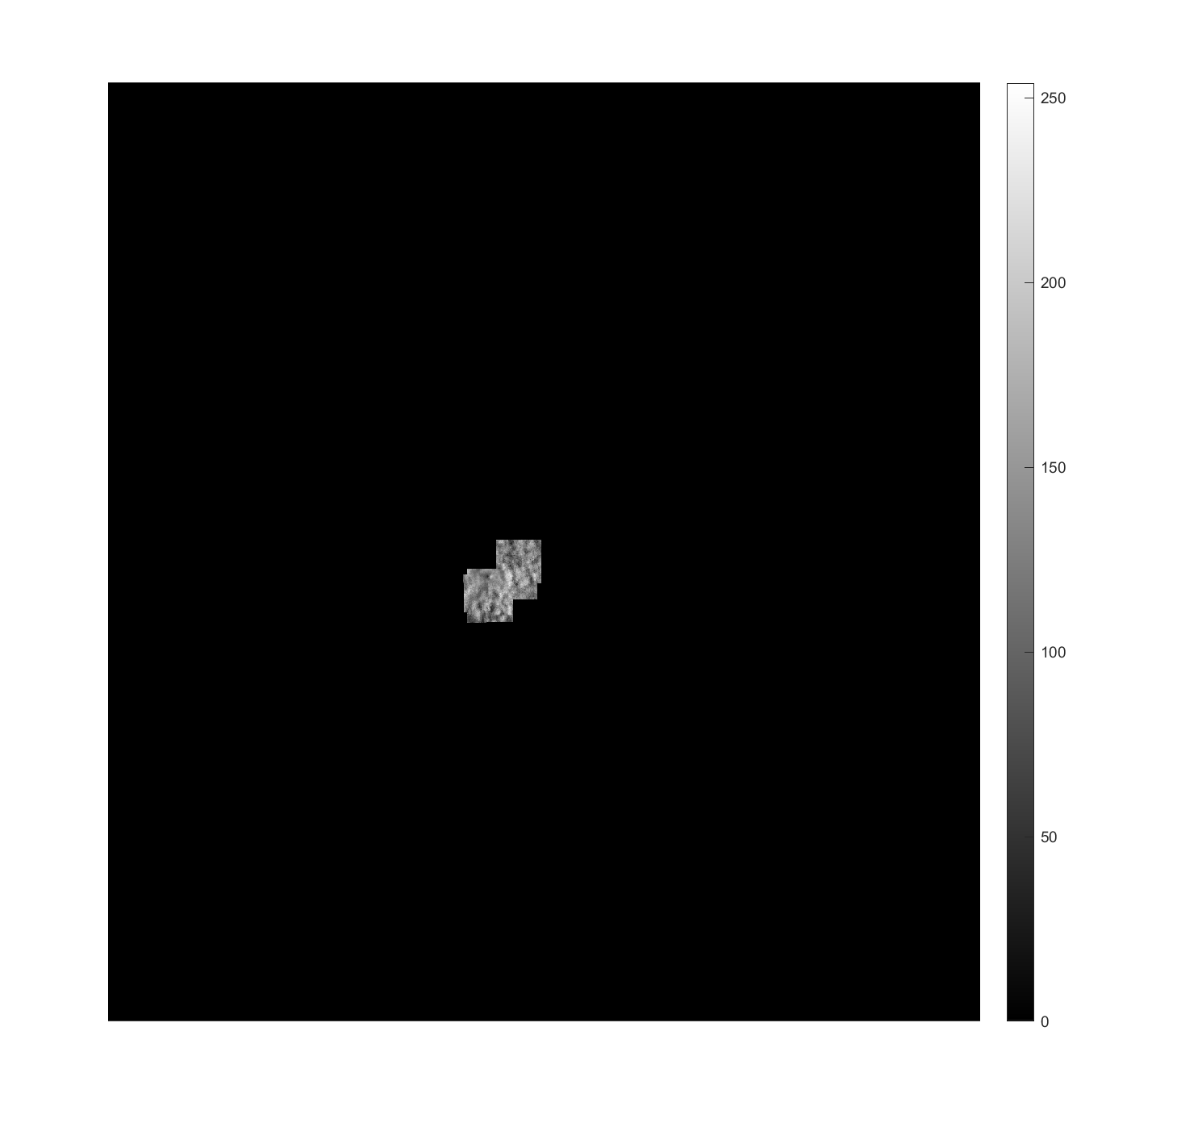

Slide 54
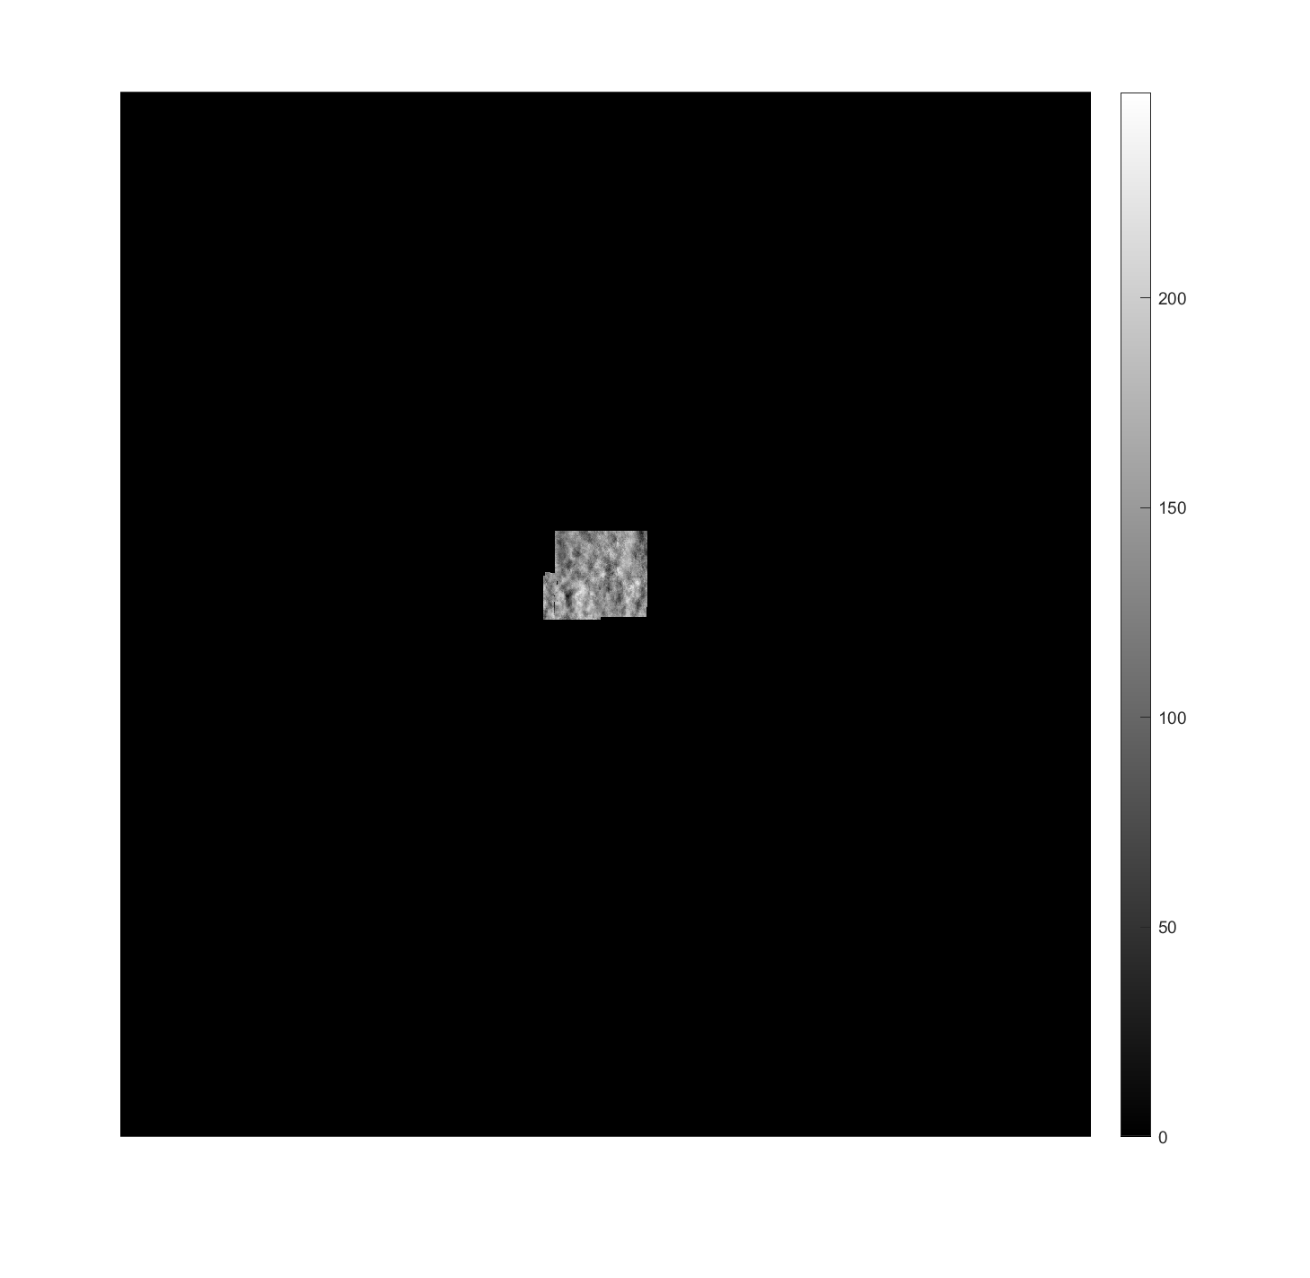

Slide 55
Summary
5 Datasets
26 locations
5 images at each location

